Slide 1



# AWS Account Creation # EMR Spark Cluster # S3 Storage # Delete data in S3 # Terminate all Clusters

Slide 2
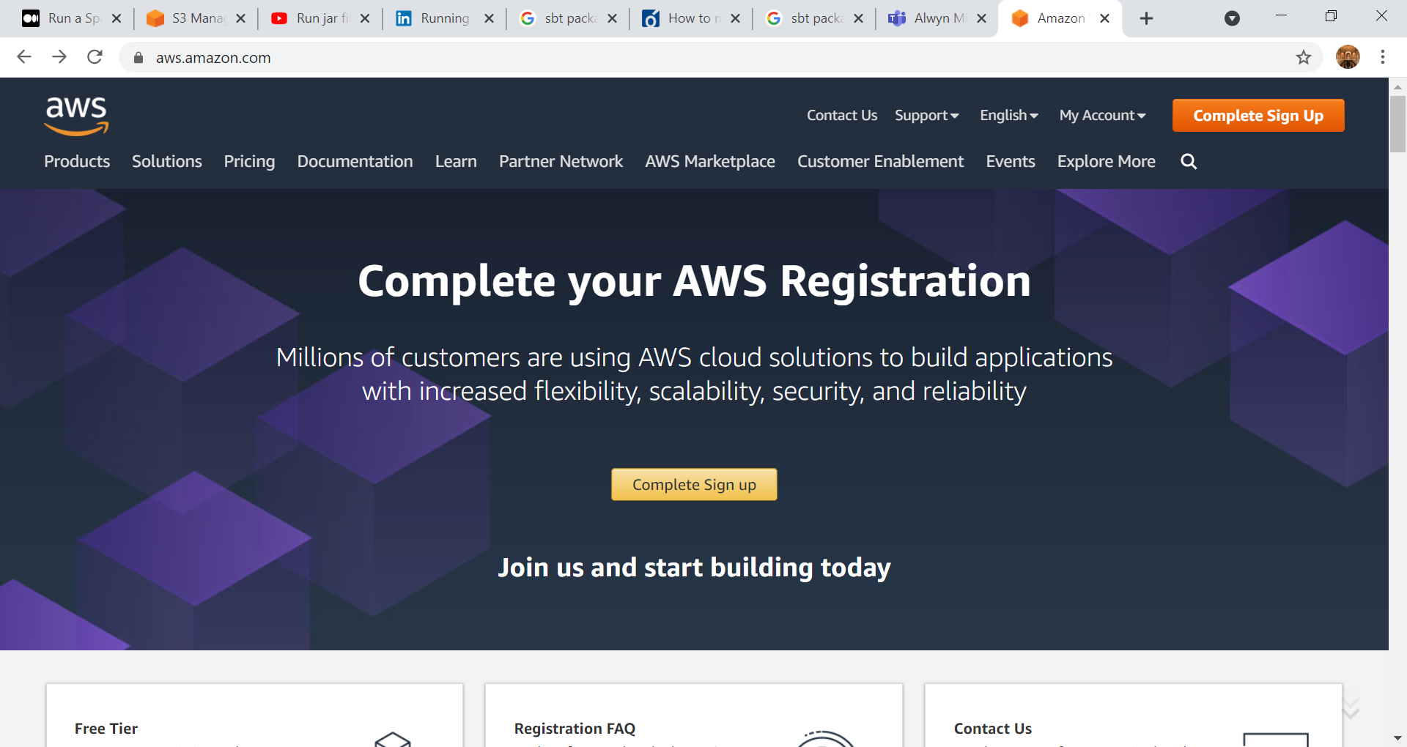

Slide 3

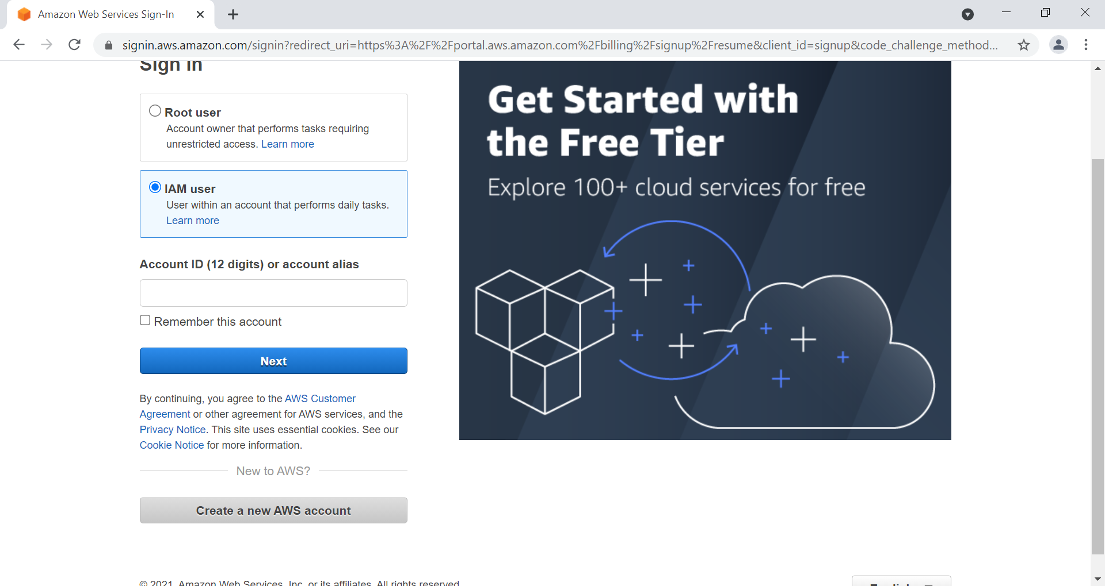

Slide 4
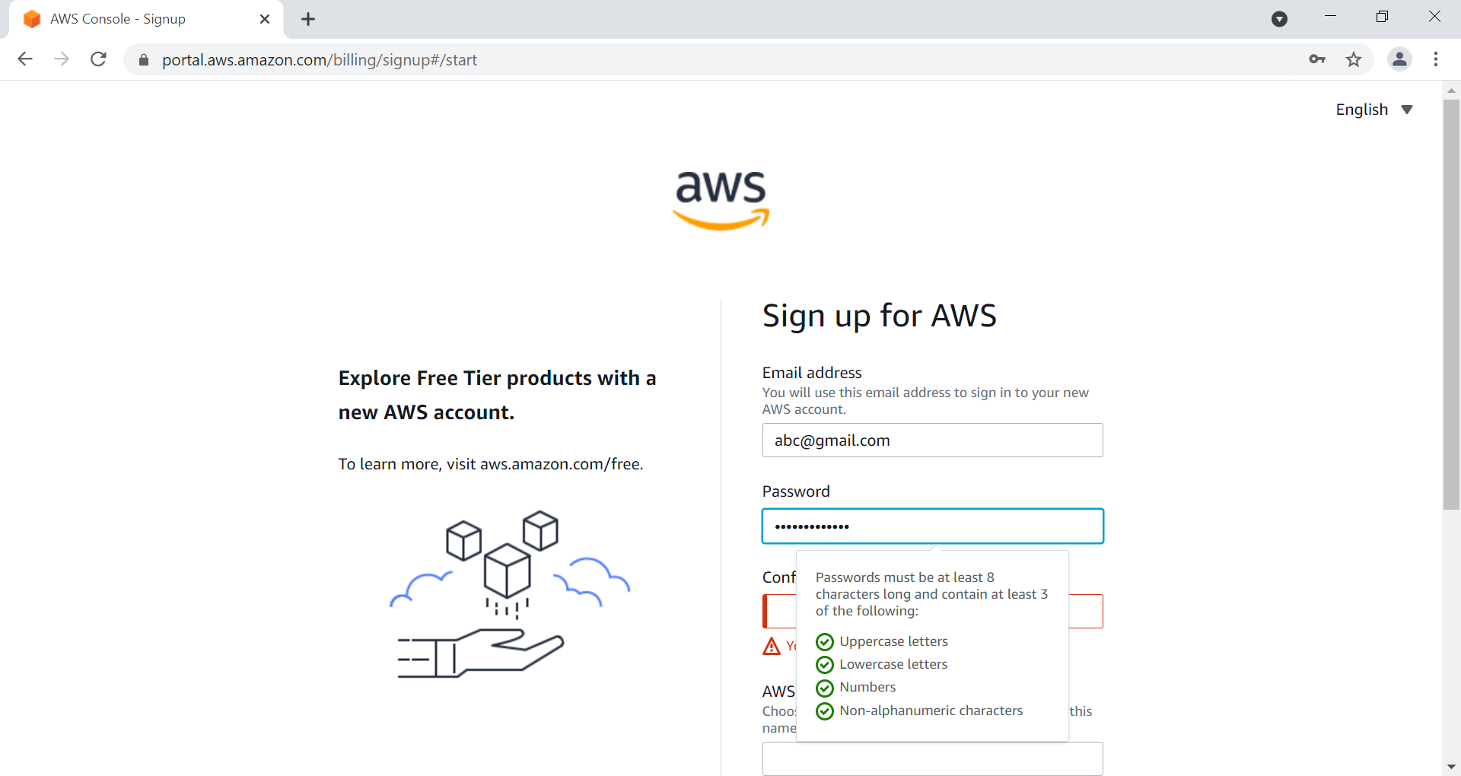

Slide 5
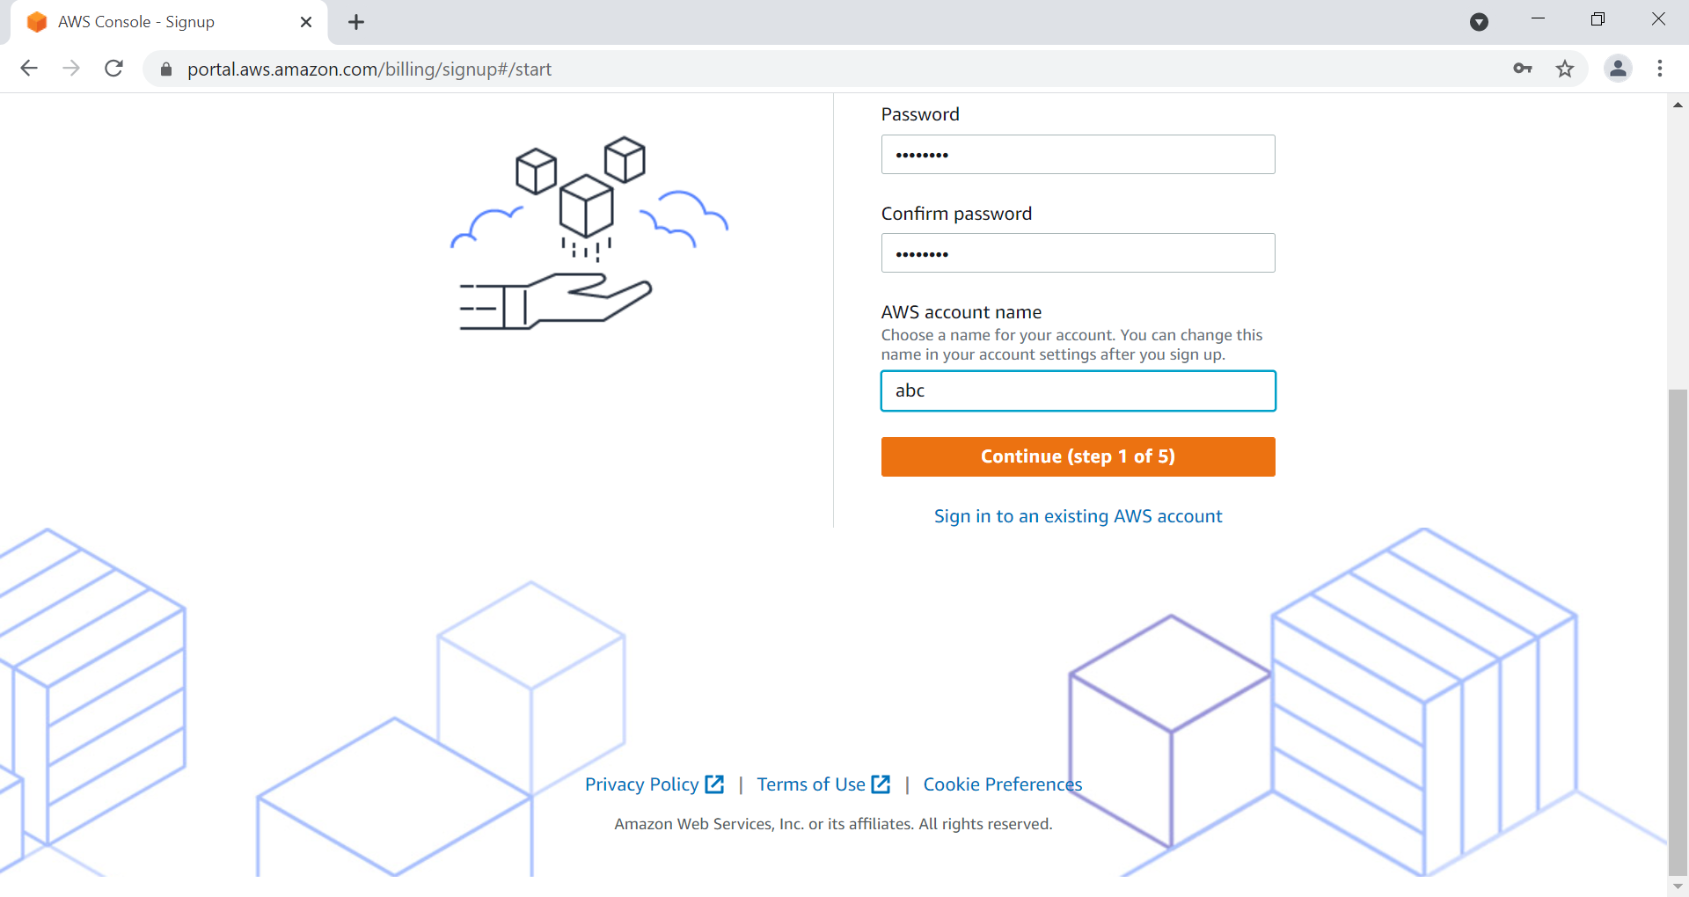

Slide 6
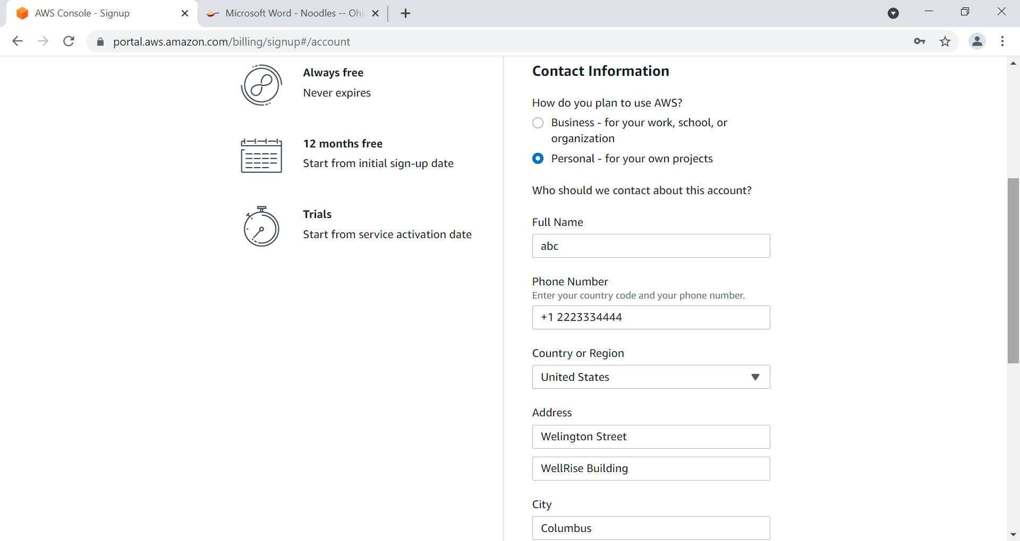

Slide 7
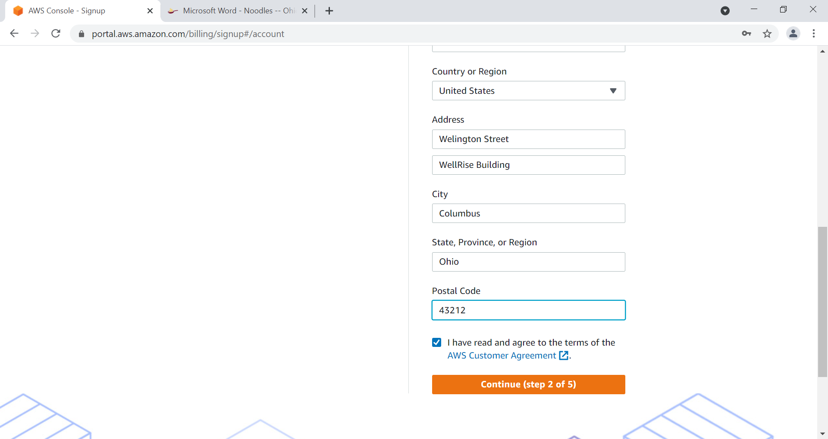

Slide 8
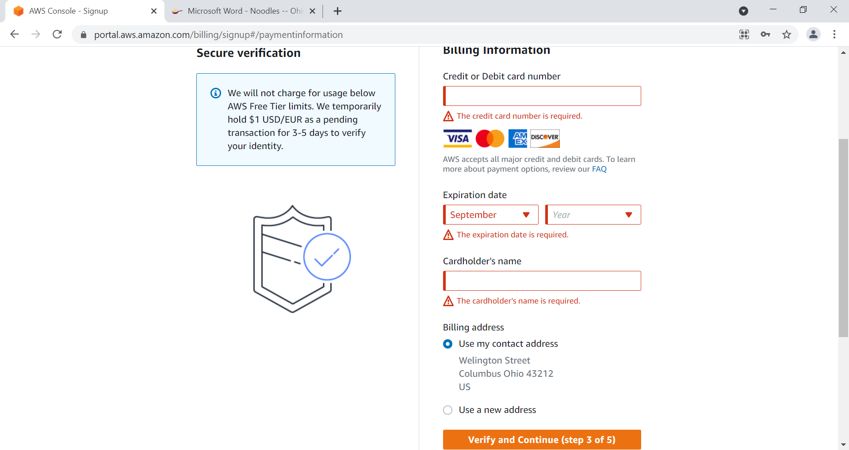

Slide 9
After SignUp - Relogin

Slide 10
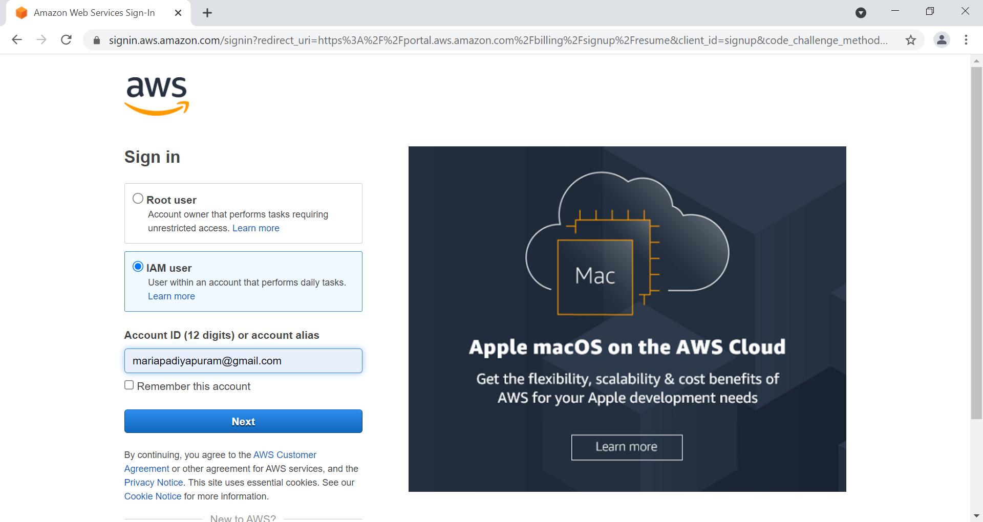

Slide 11
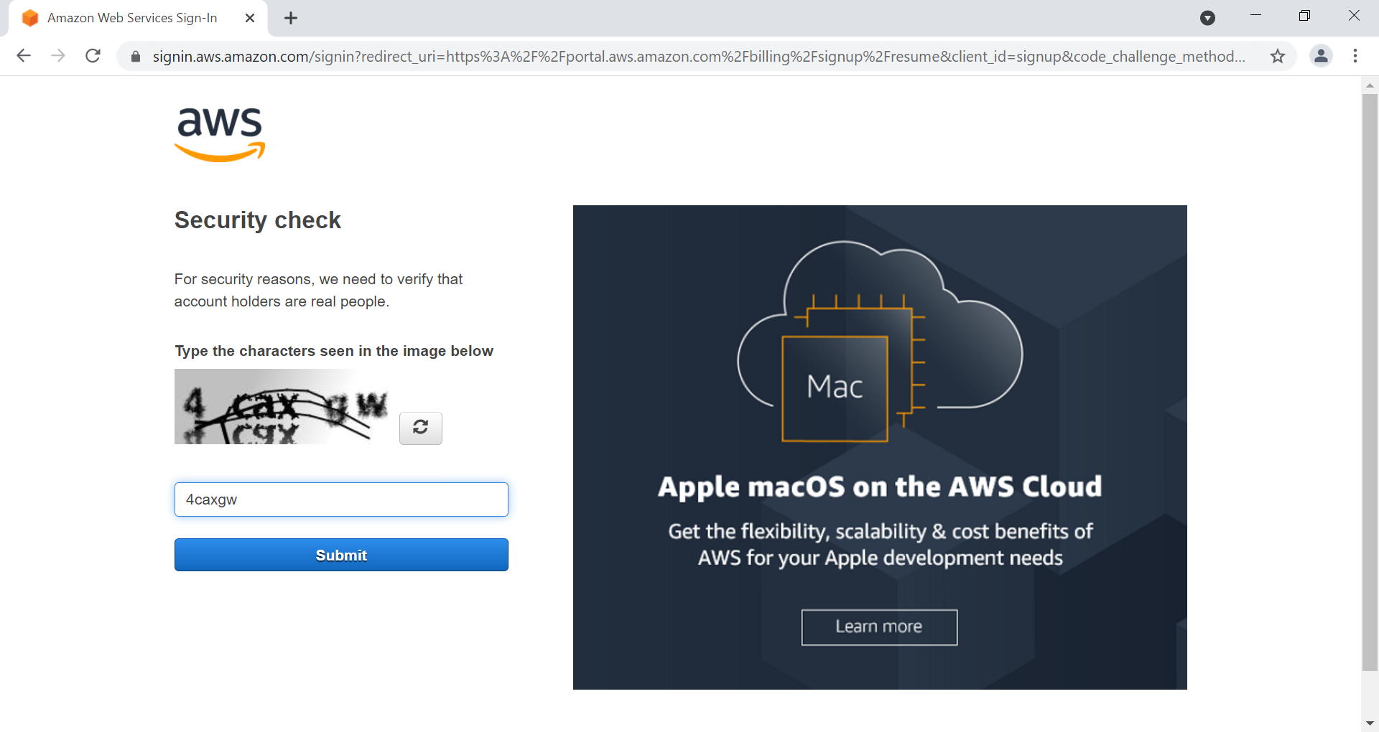

Slide 12
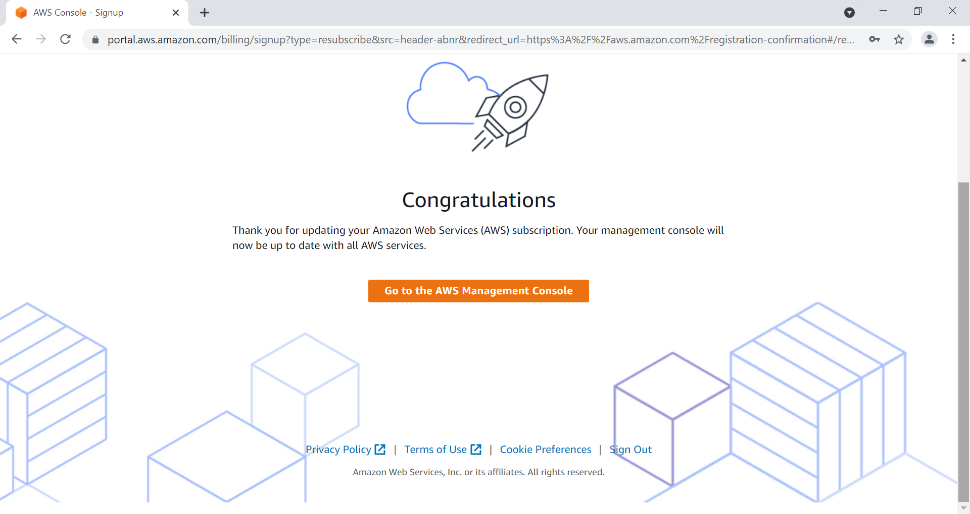

Slide 13
Click on AWS Management Console

Slide 14
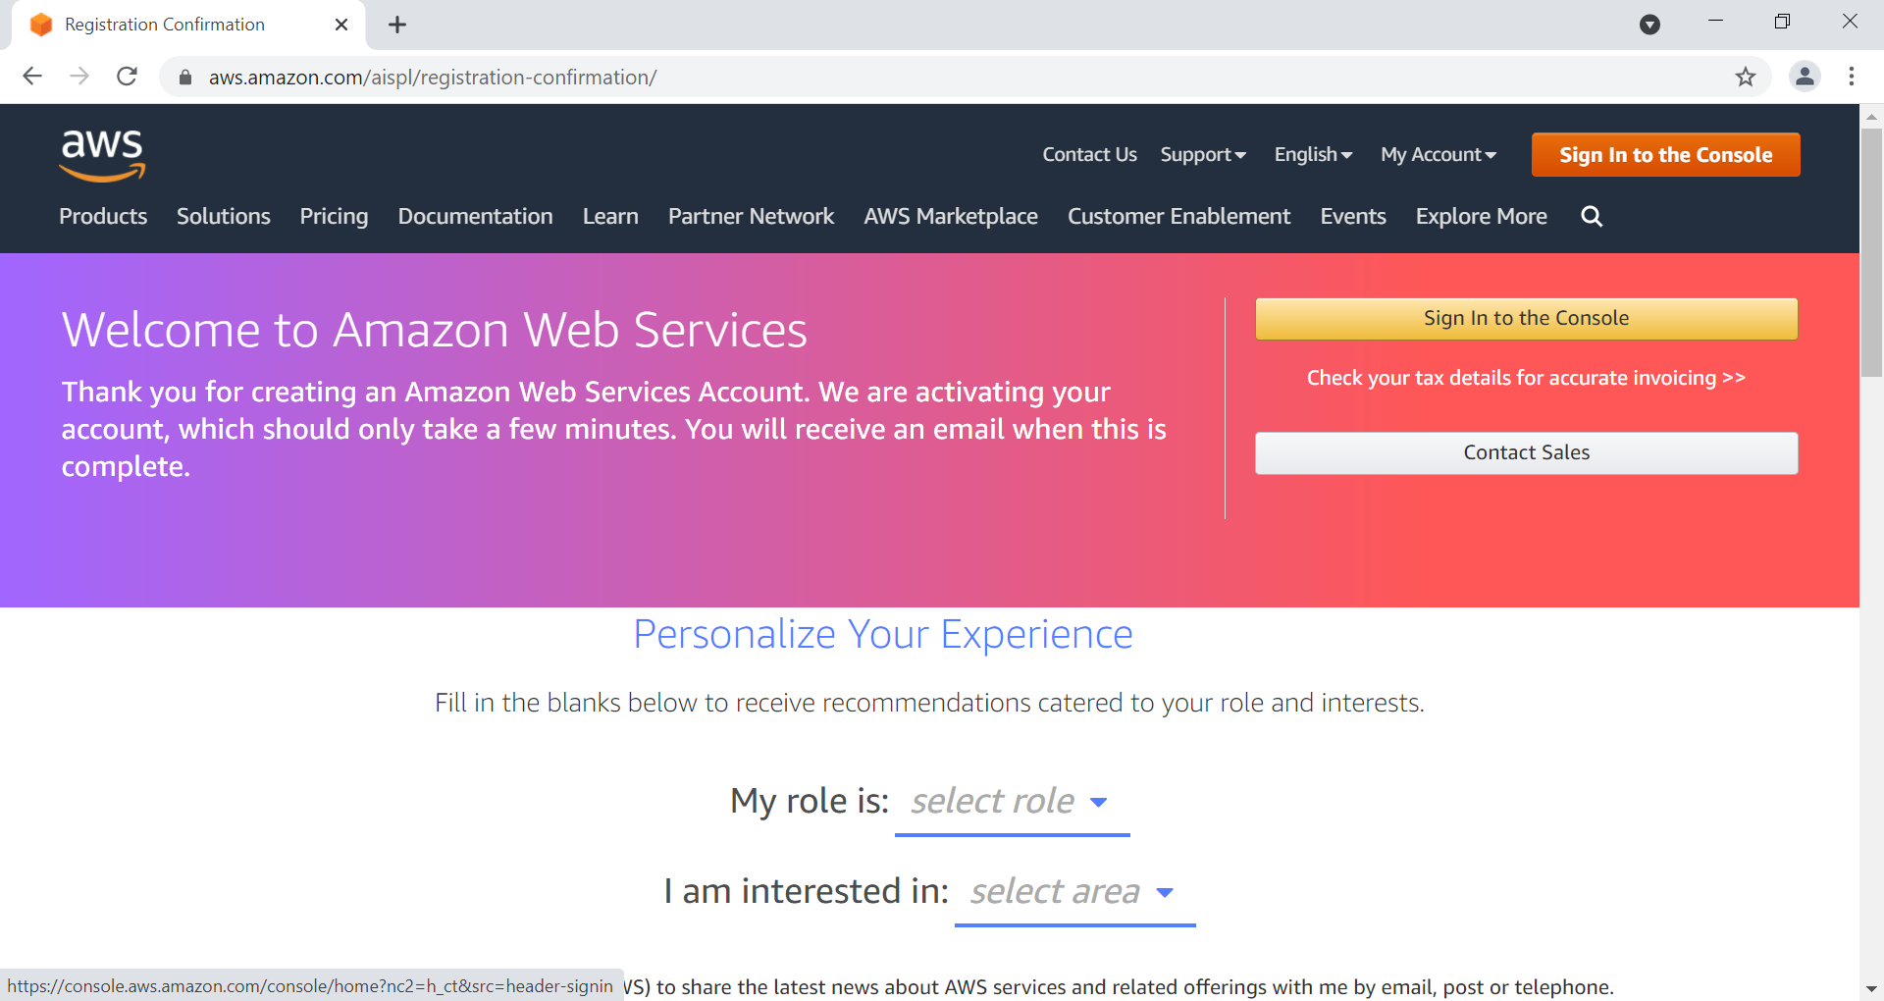

Slide 15
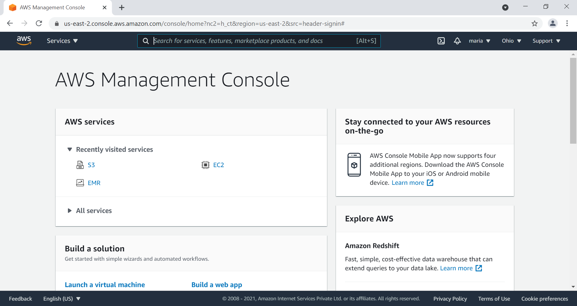

Slide 16
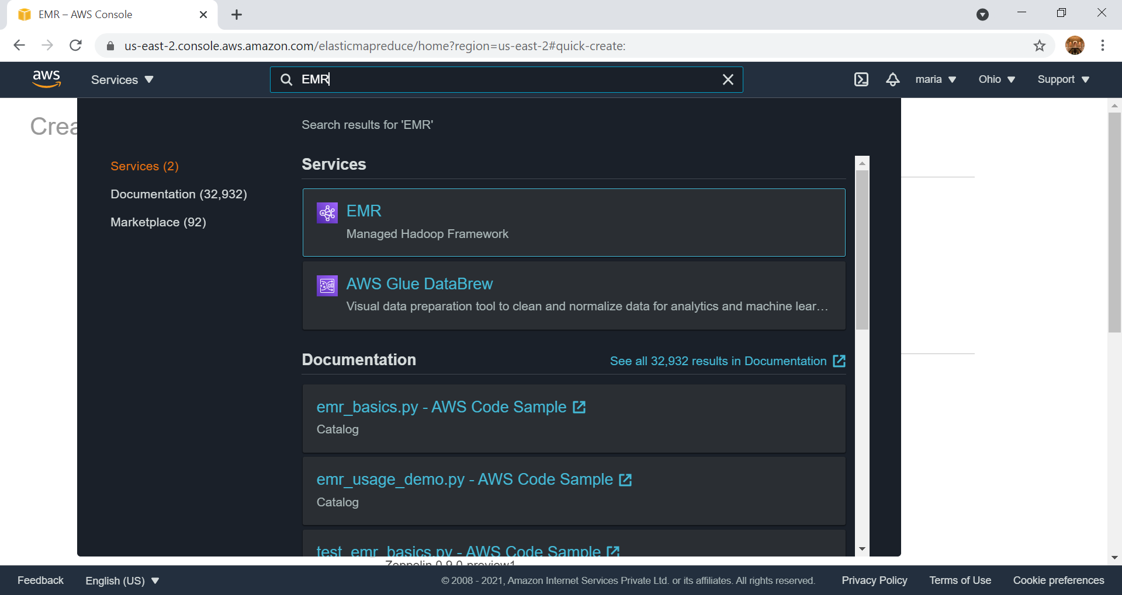

Slide 17
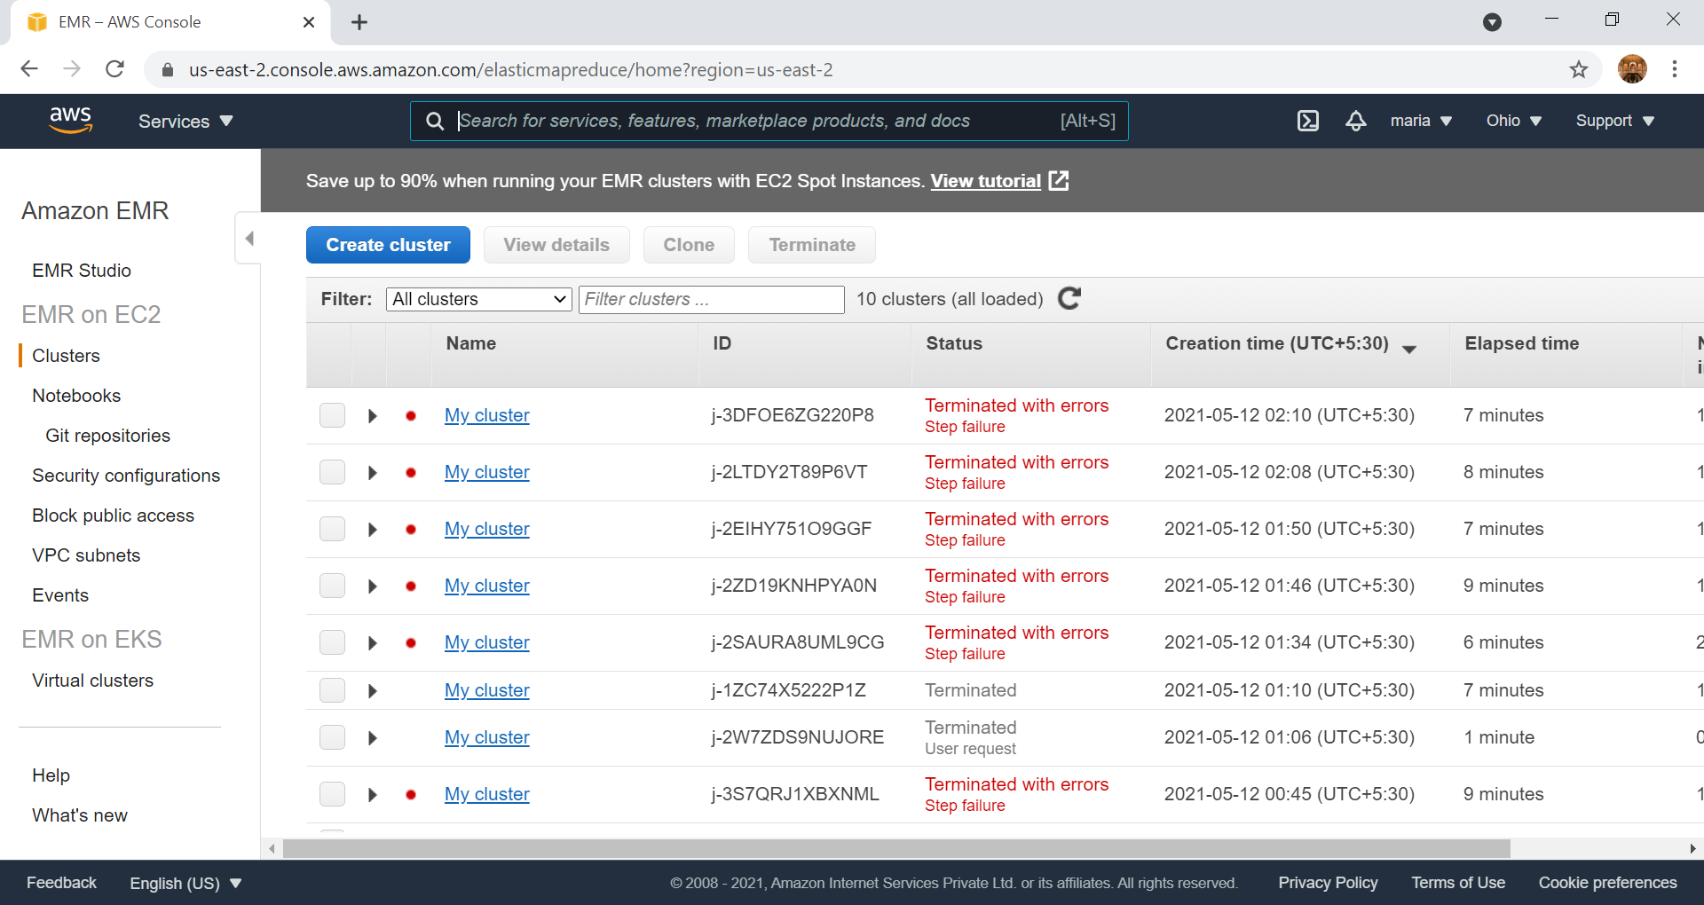

Slide 18
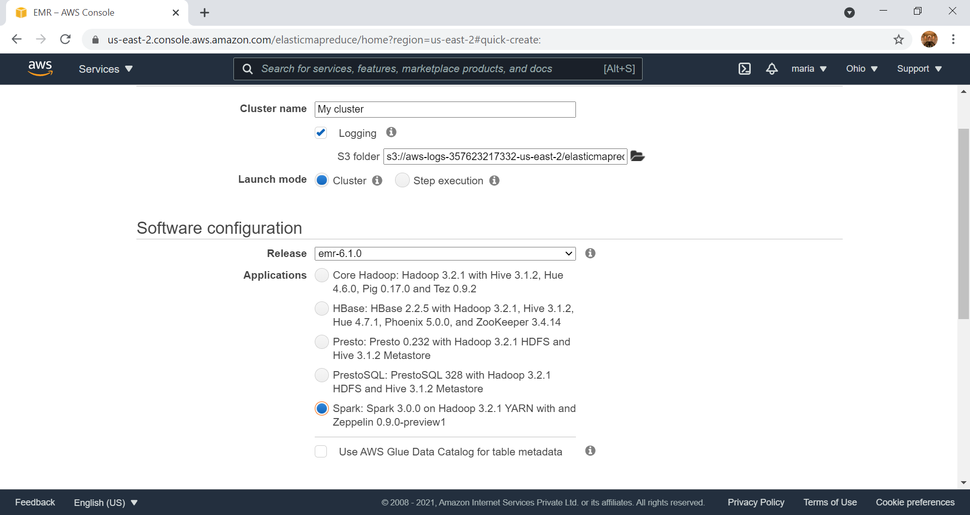

Slide 19
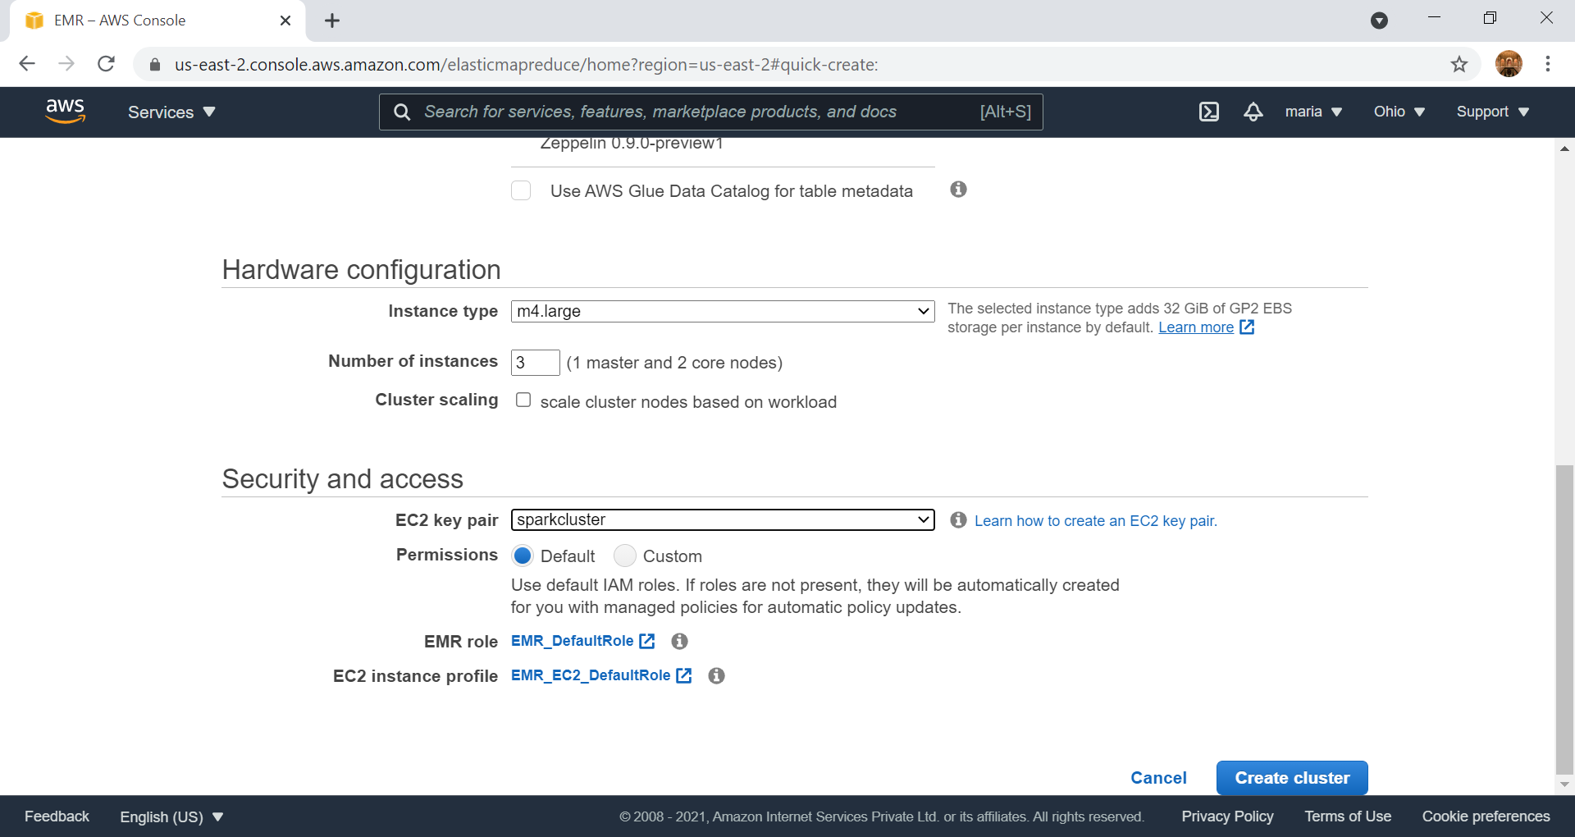

Slide 20
Create EC2 Key pair

Slide 21
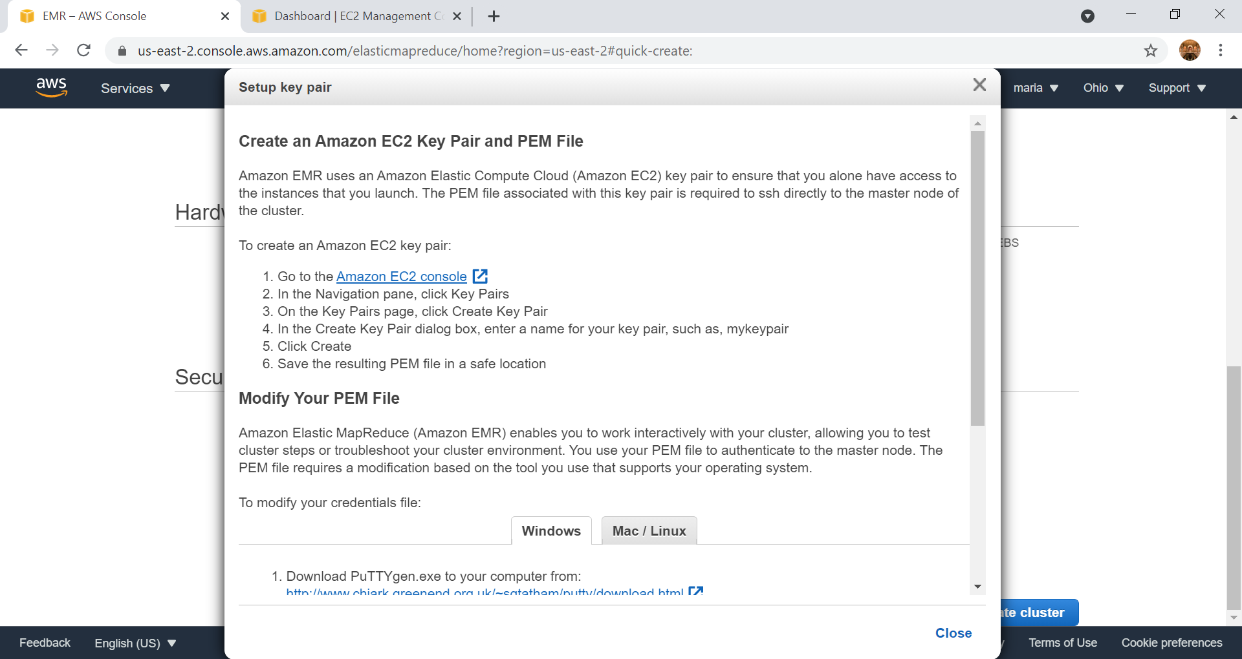

Slide 22
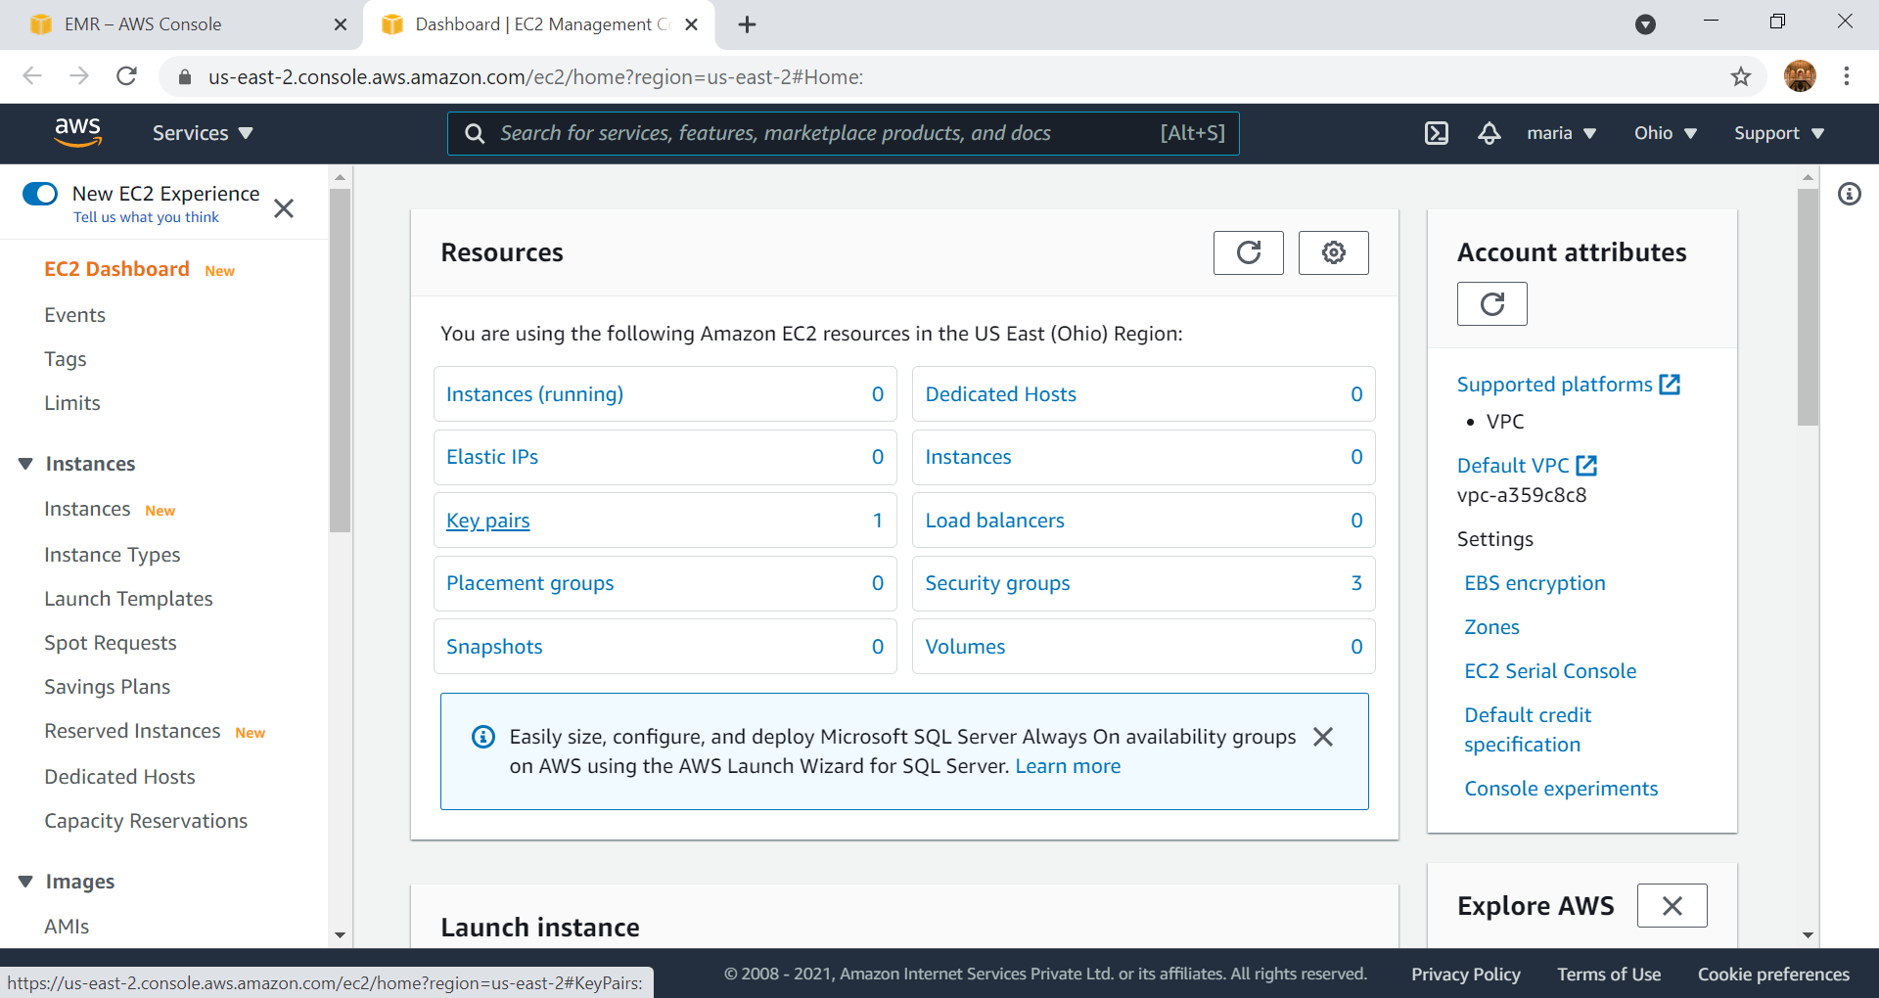

Slide 23
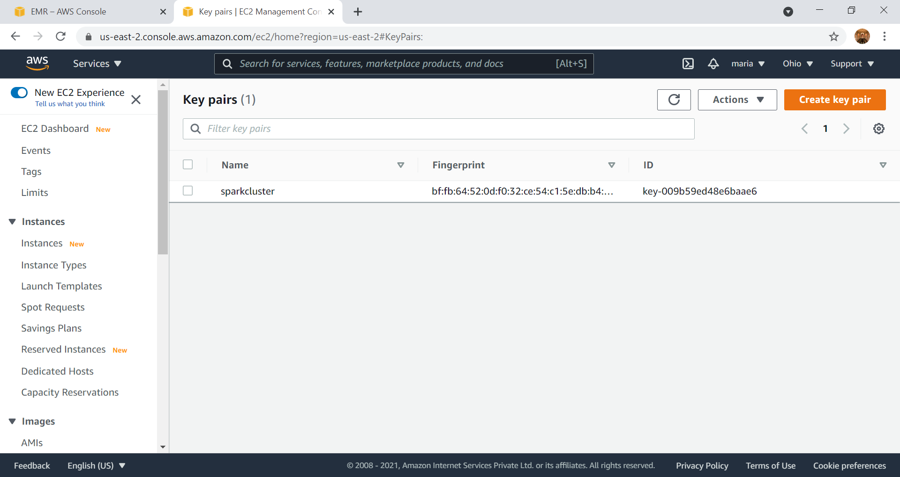

Slide 24
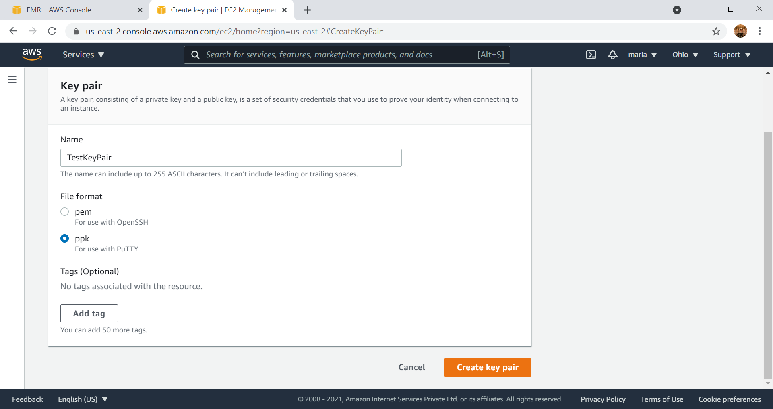

Slide 25
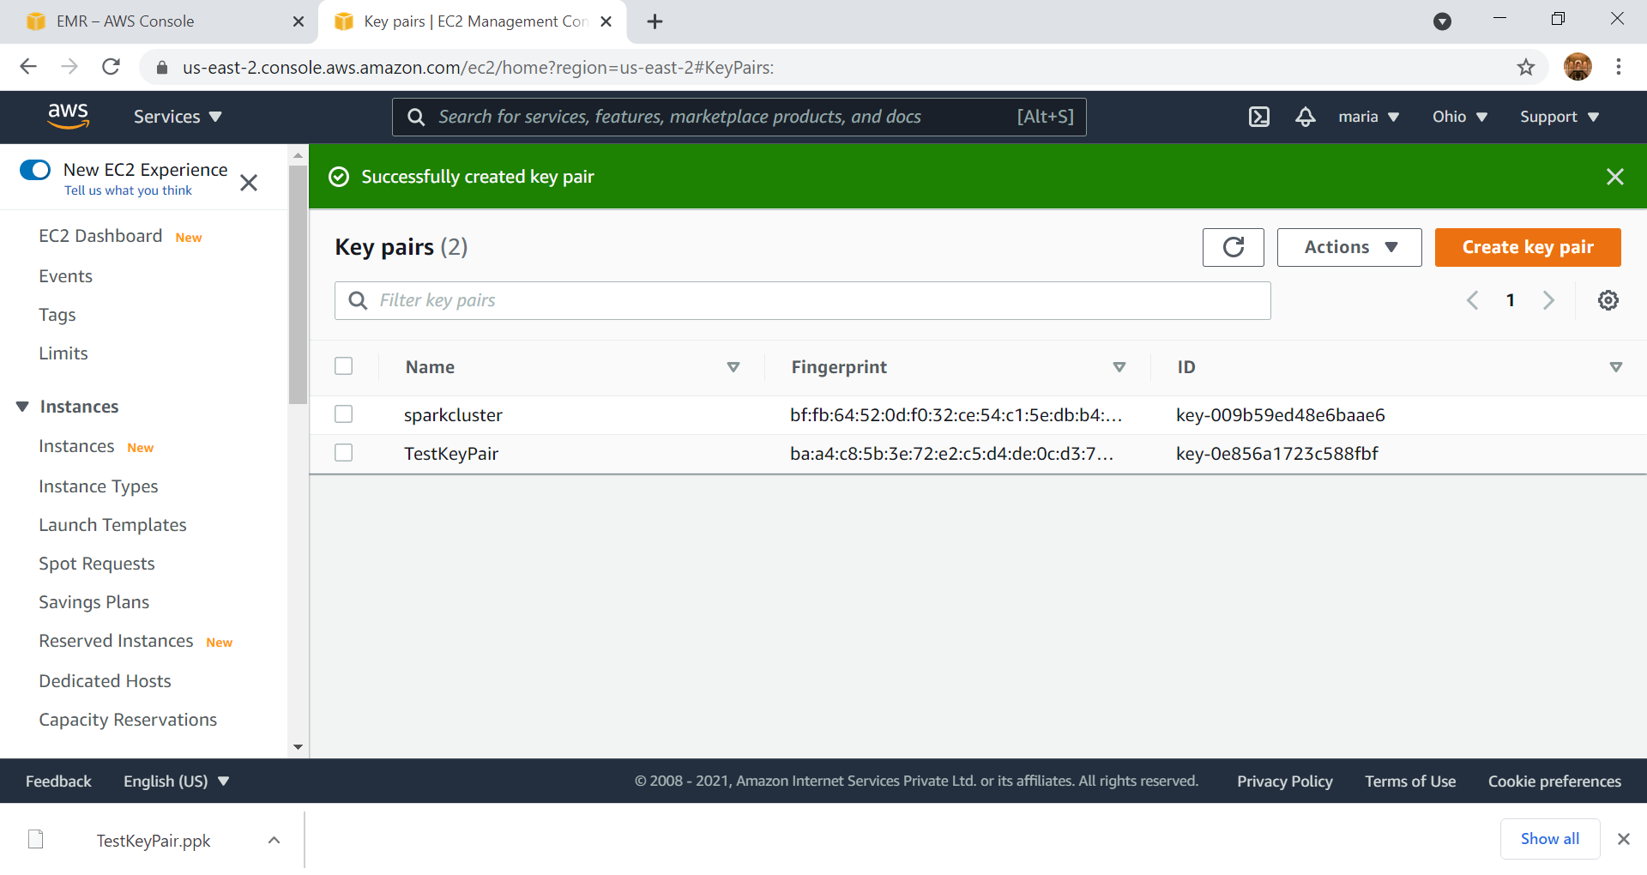

Slide 26
Start Cluster

Slide 27
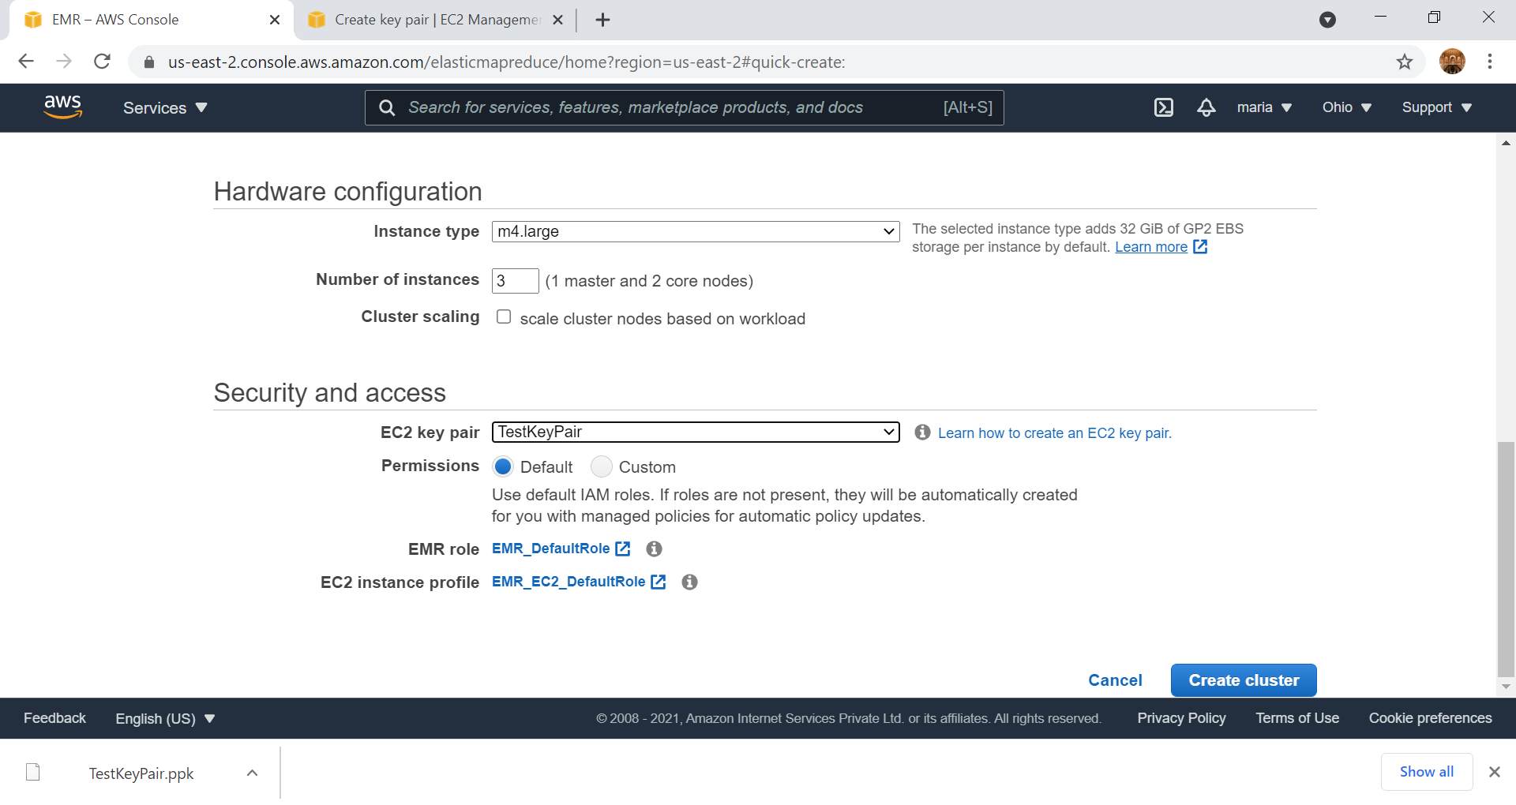

Slide 28
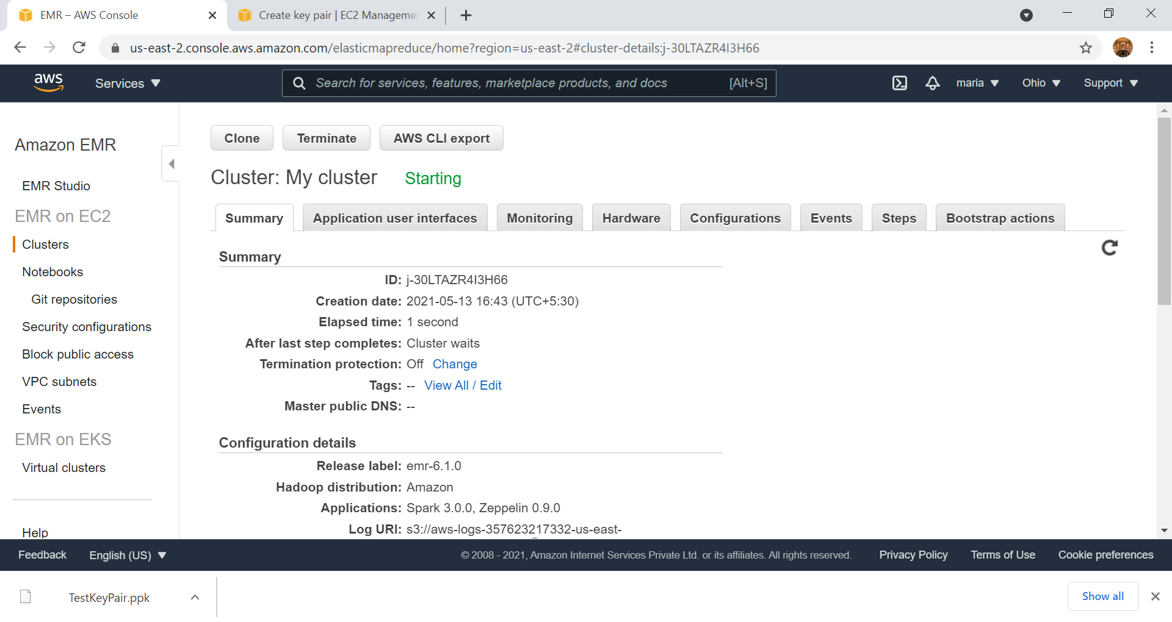

Slide 30
HelloSpark
Print in AWS EMR

Slide 31
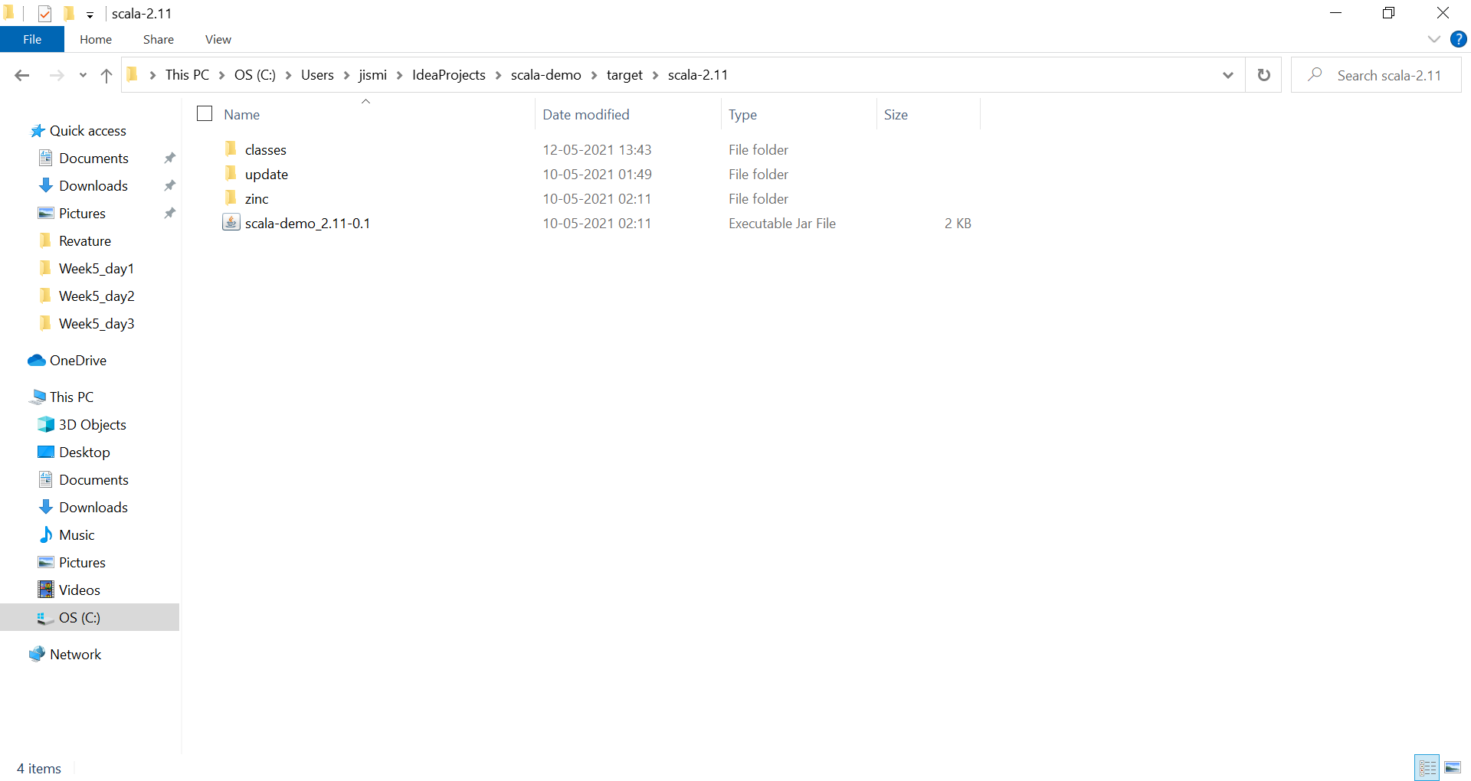
Jar Location

Slide 32
IF USING PYTHON, UPLOAD THE .py FILE INSTEAD

Slide 33
Create a Bucket in S3
Create a Folder
Upload the JAR file (.py for python) in S3

Slide 34
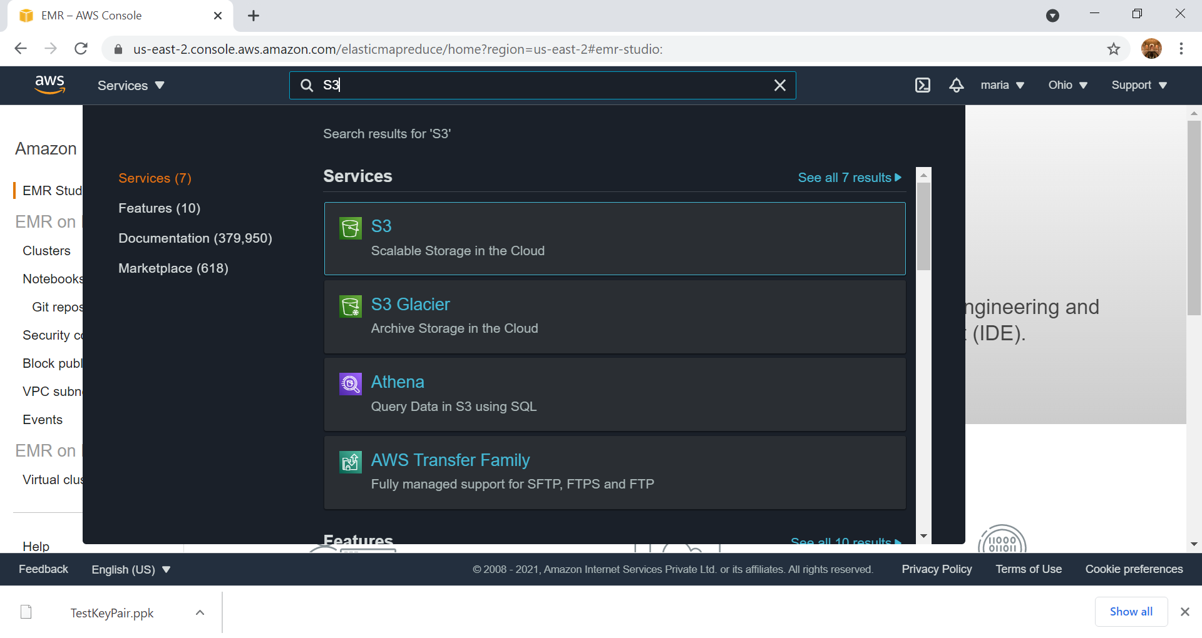

Slide 35
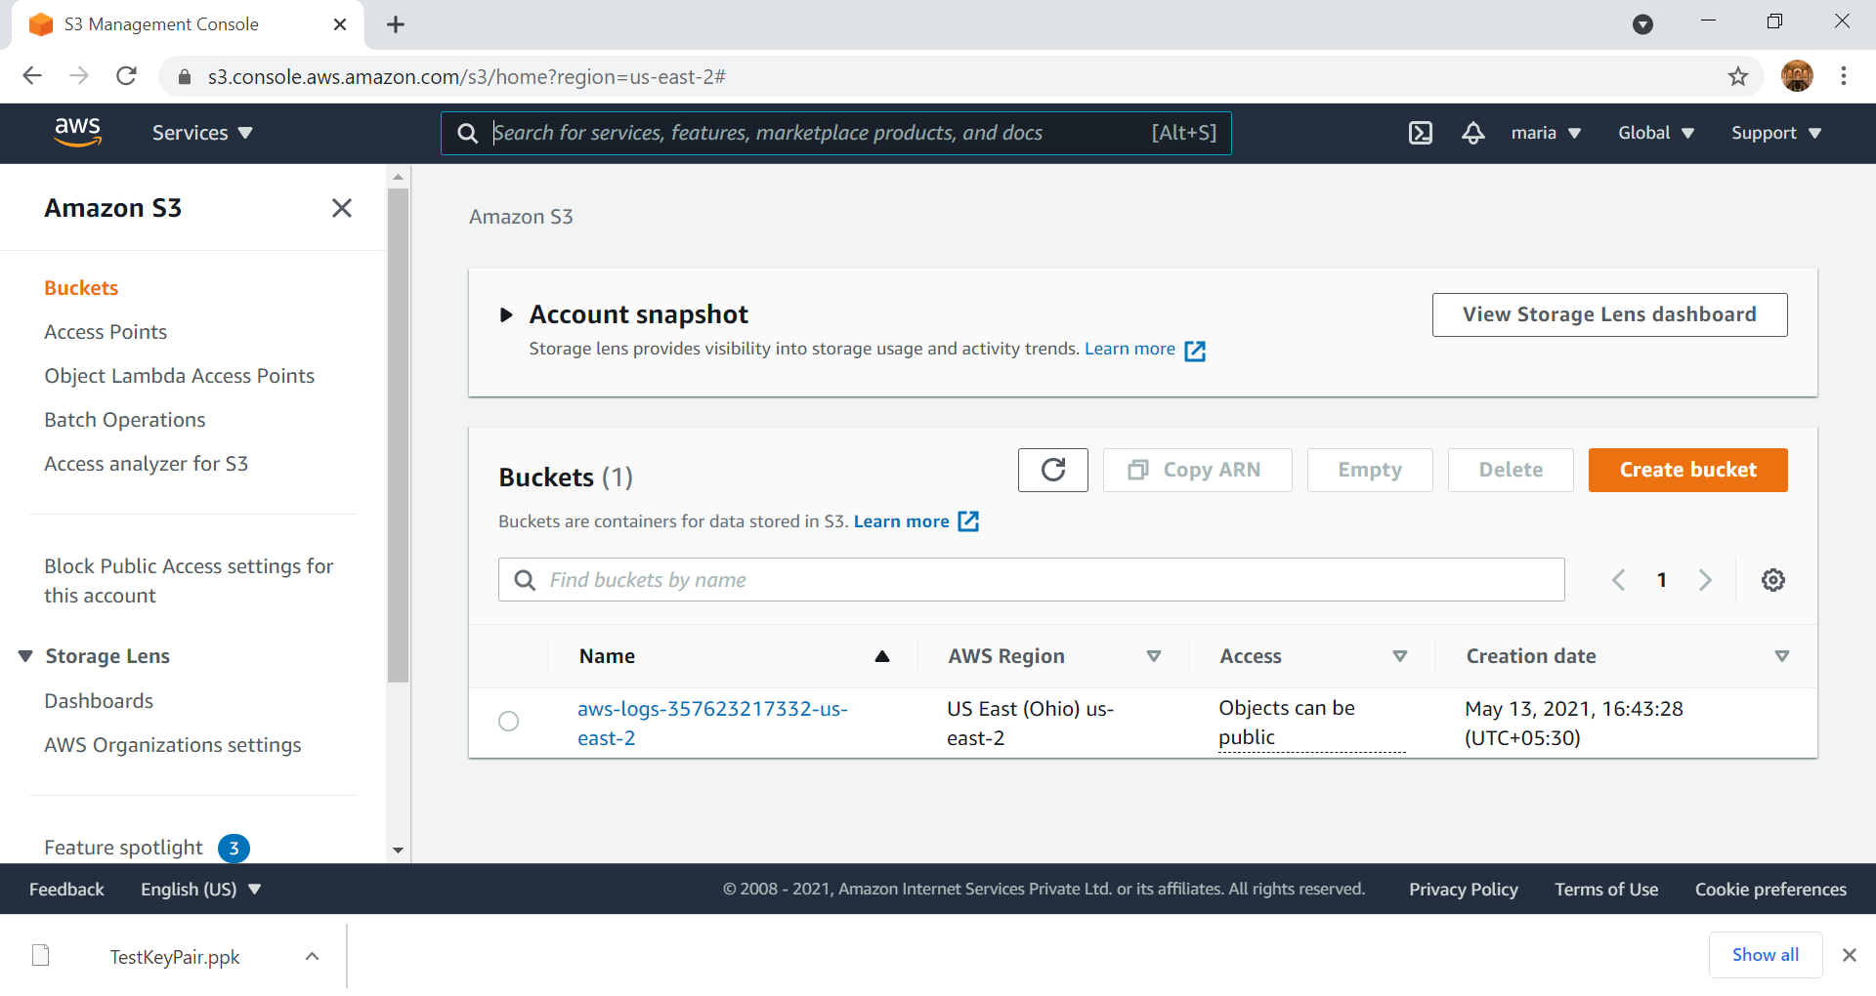

Slide 36
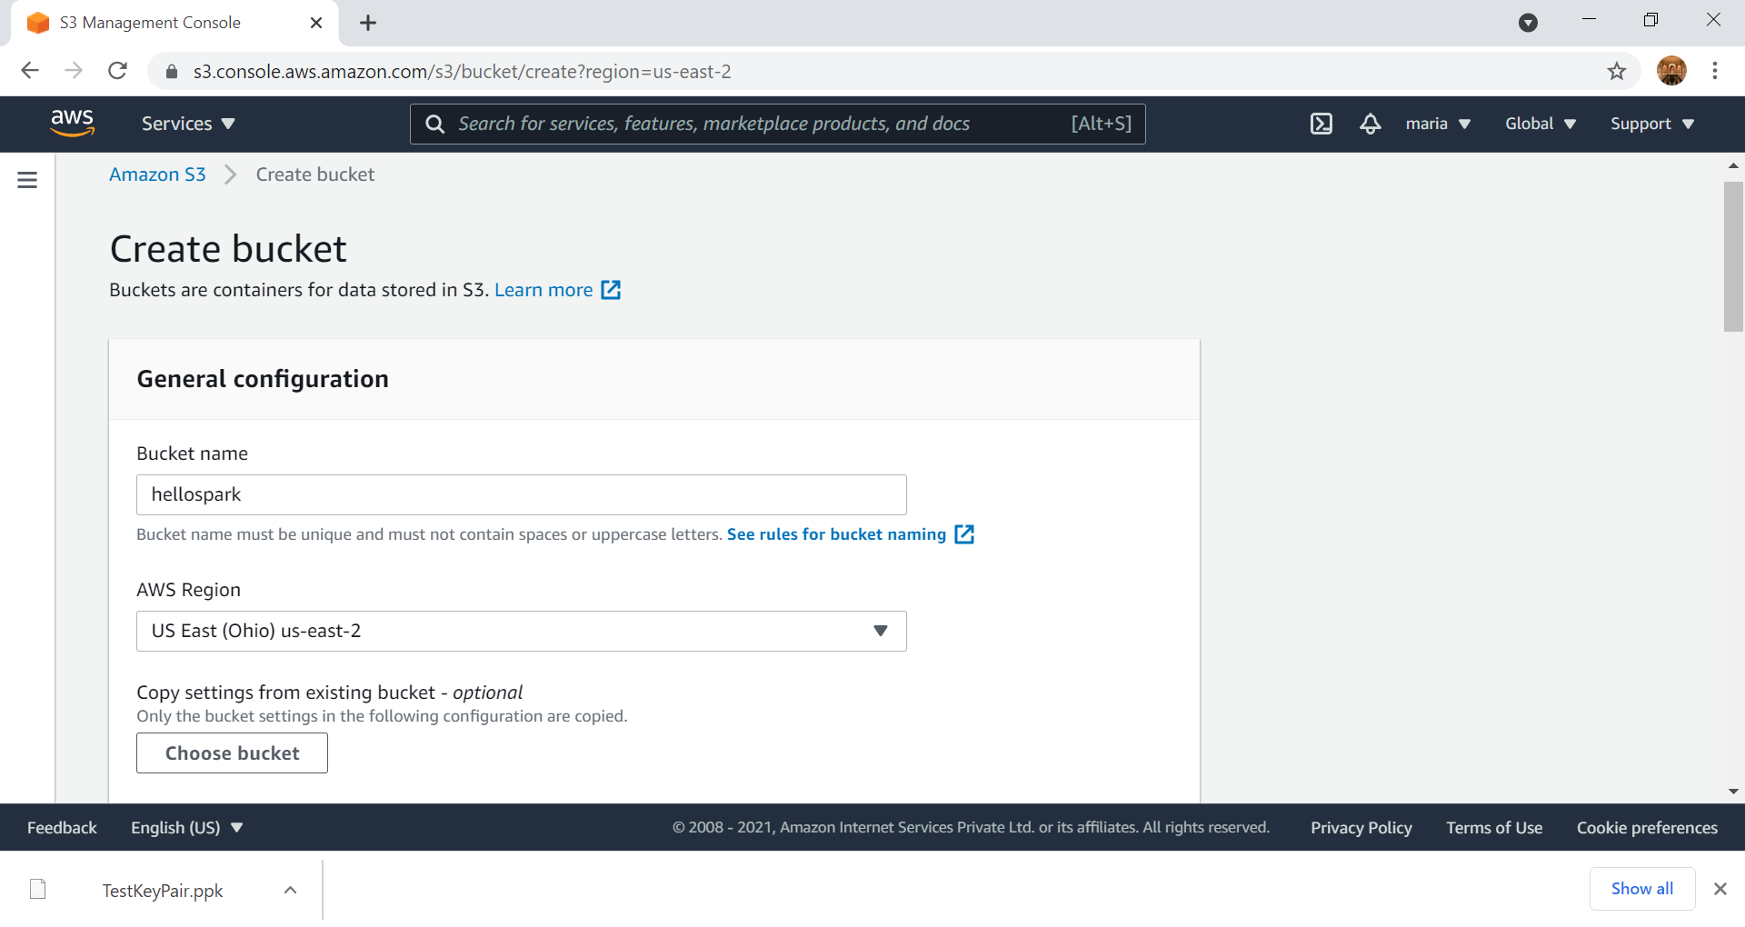
Choose the region with lowest cost/hr

Slide 37
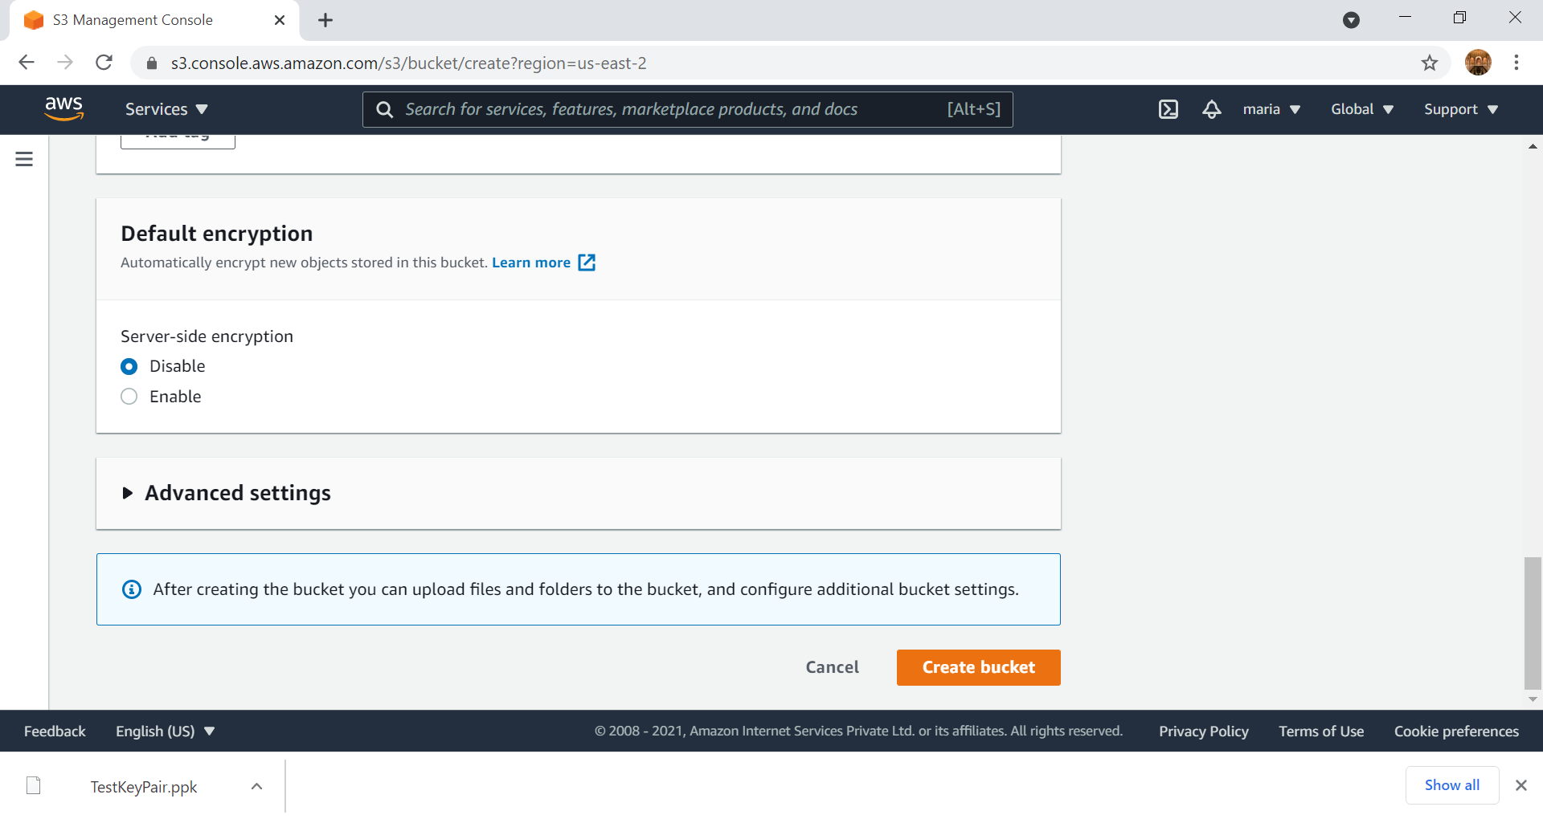
All other setting remain as default, no changes needs to be made

Slide 38
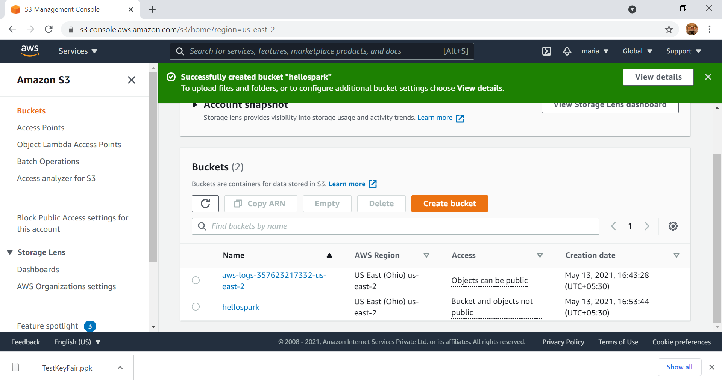
Select the folder

Slide 39
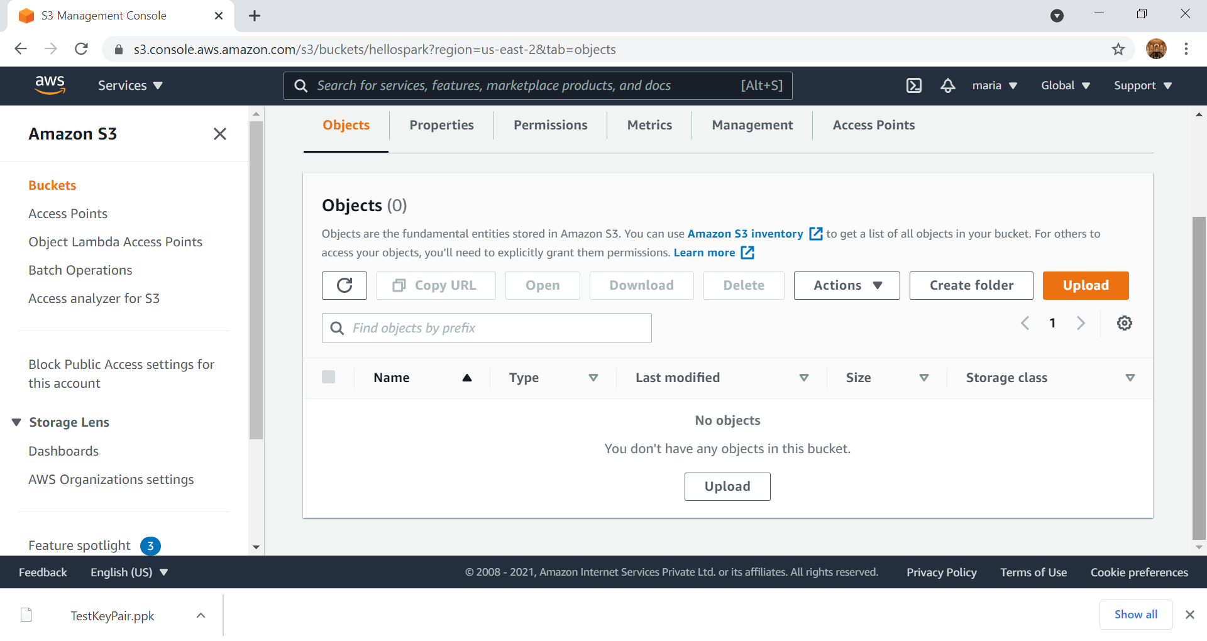

Slide 40
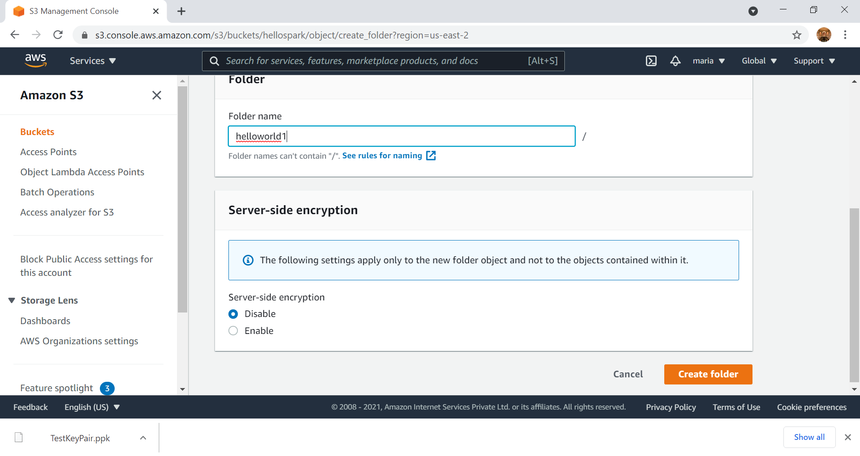

Slide 41
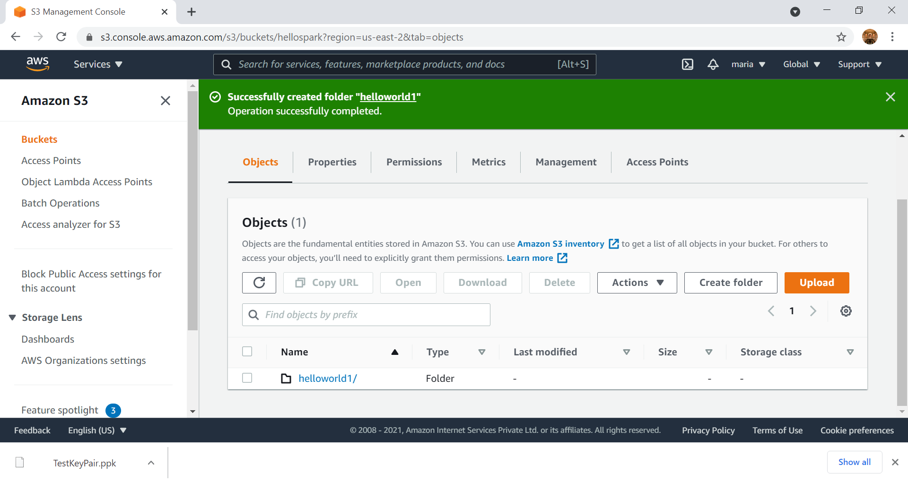
Select the folder

Slide 42
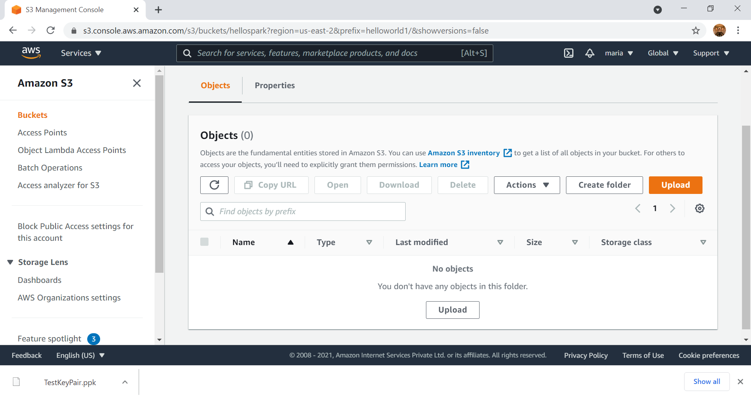

Slide 43
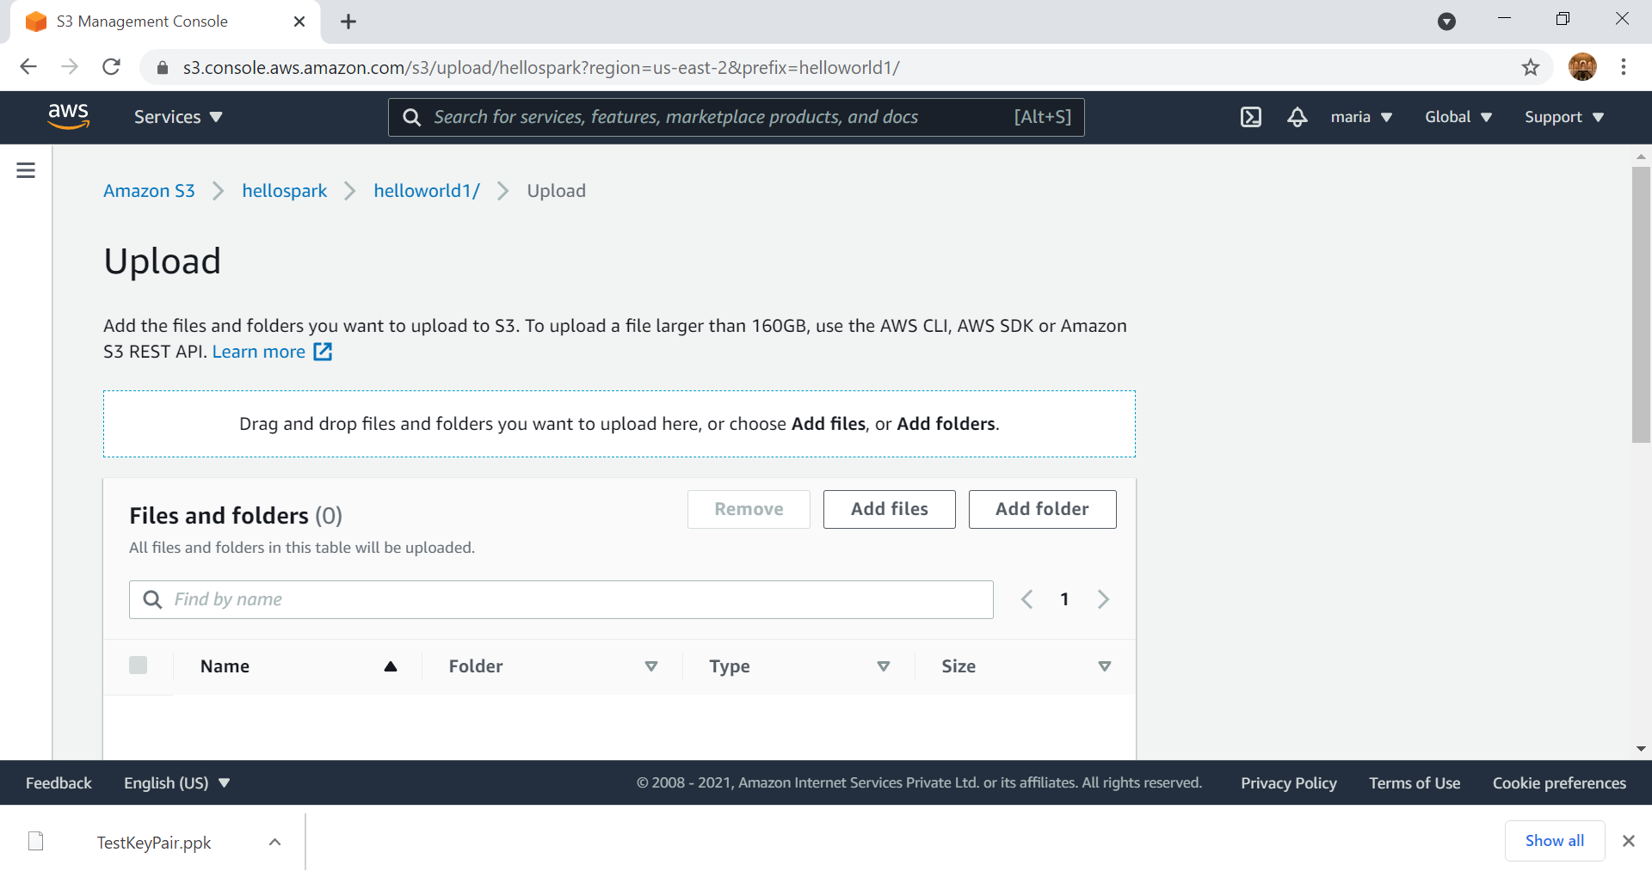

Slide 44
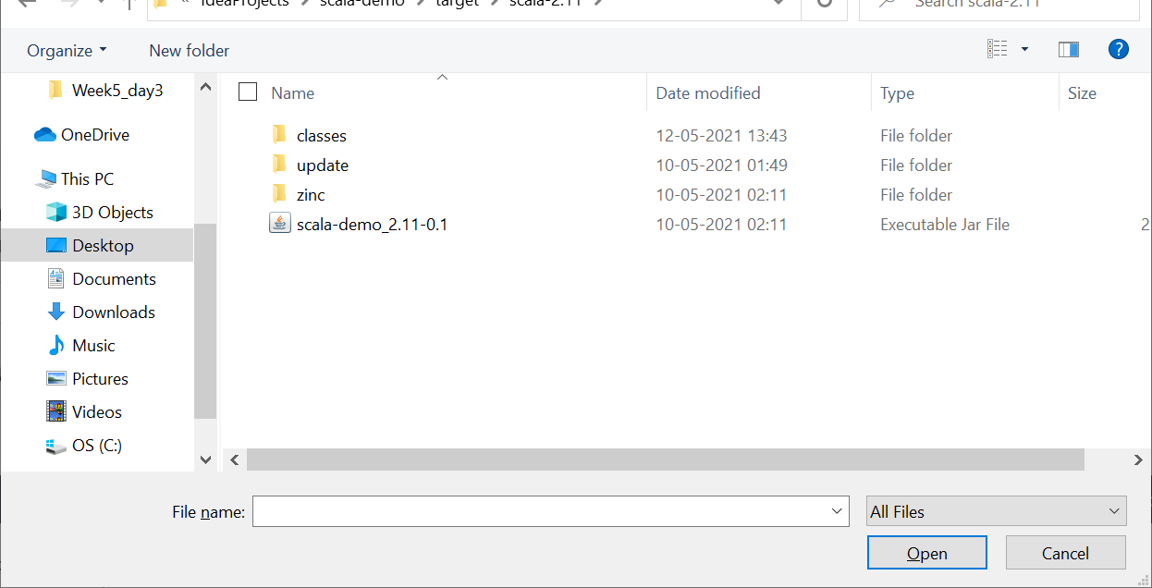
Select the location of the Jar file

Slide 45
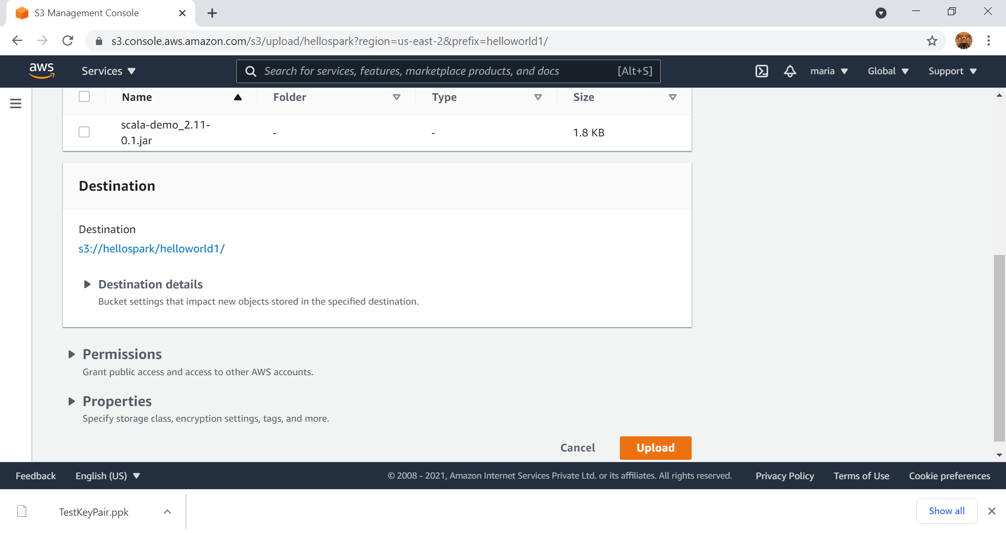

Slide 46
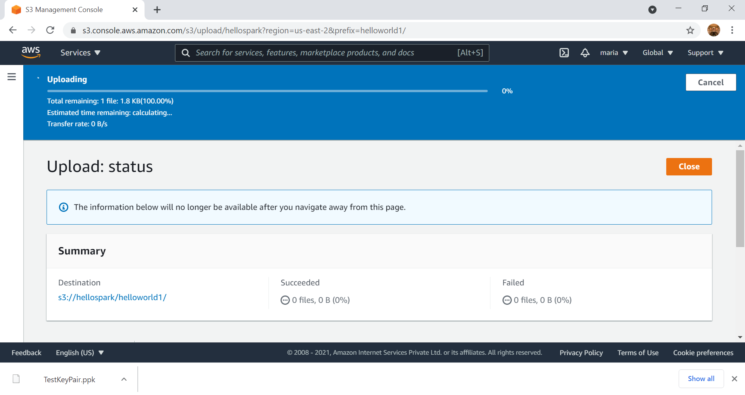

Slide 47
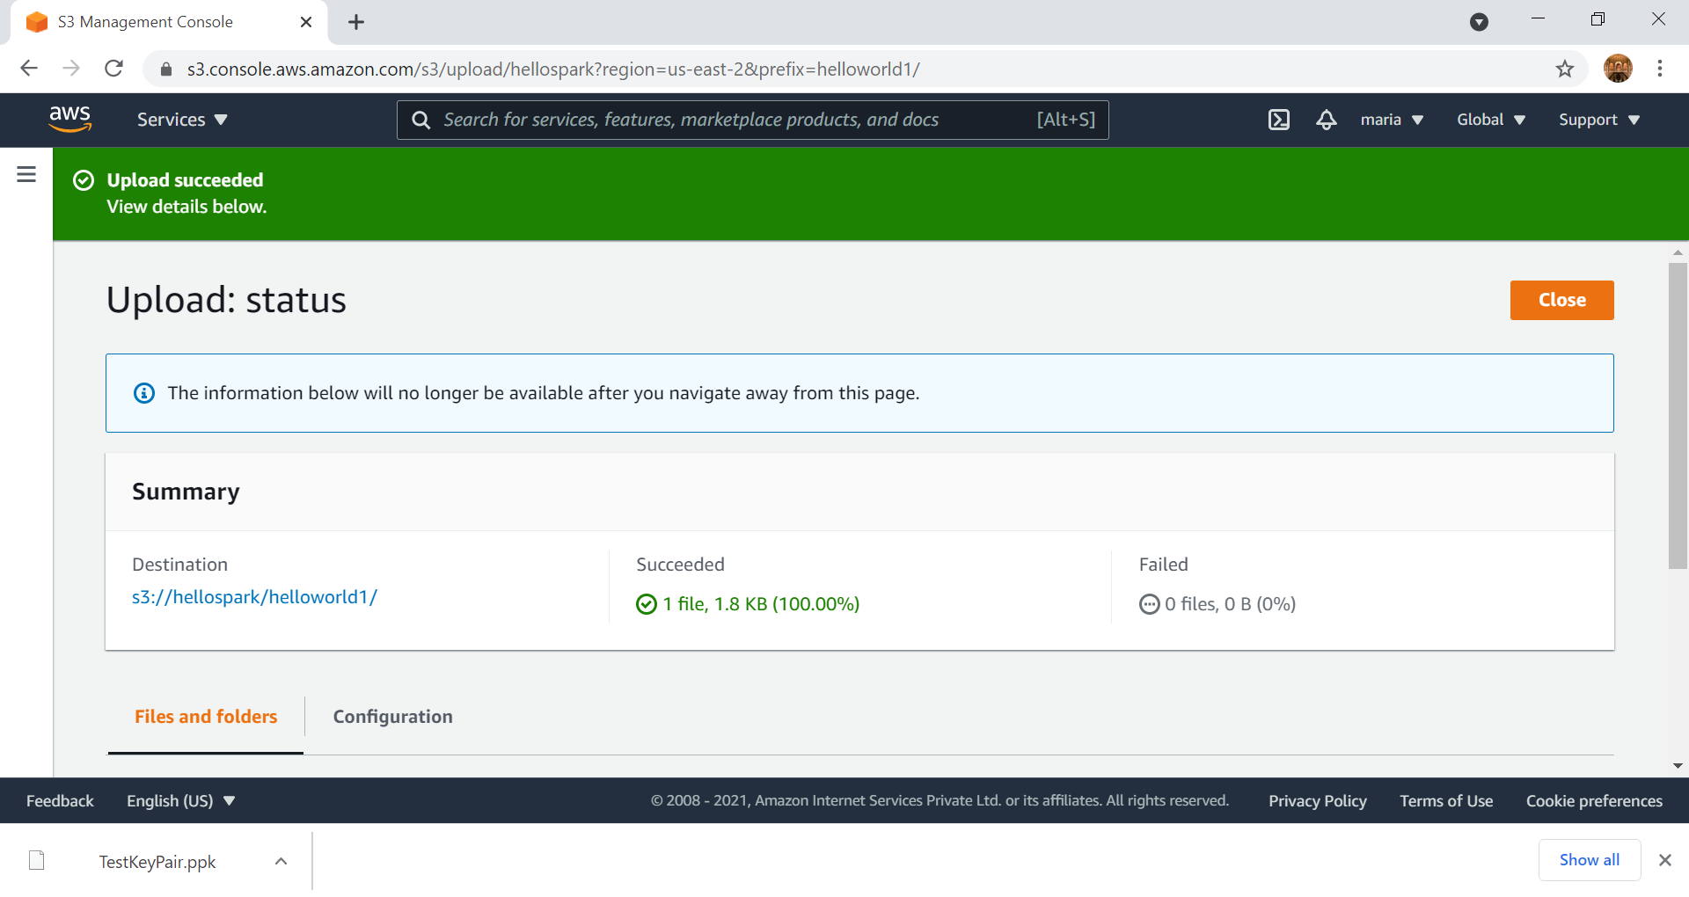

Slide 48
Go back to EMR

Slide 49
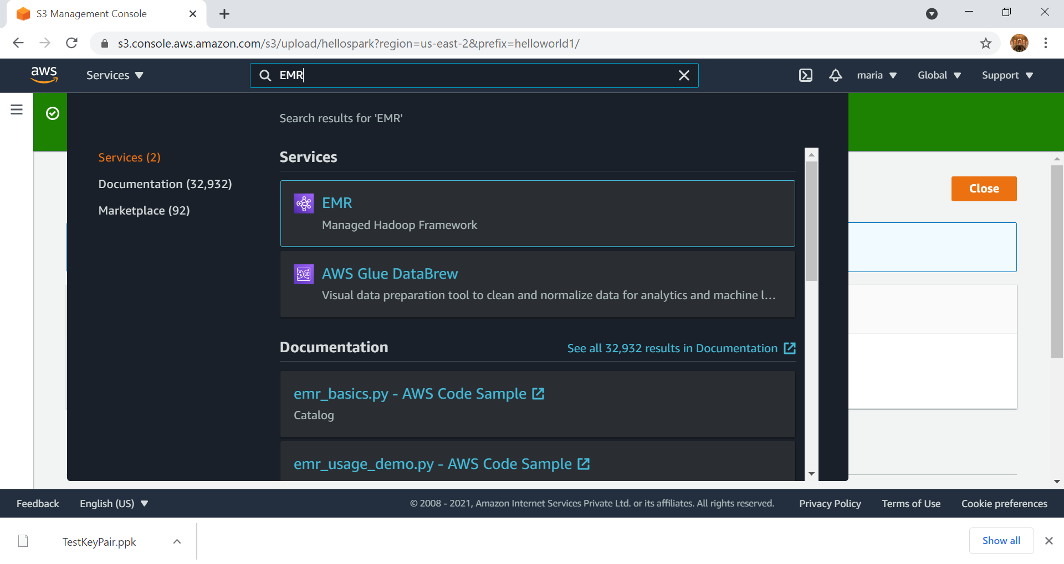

Slide 50
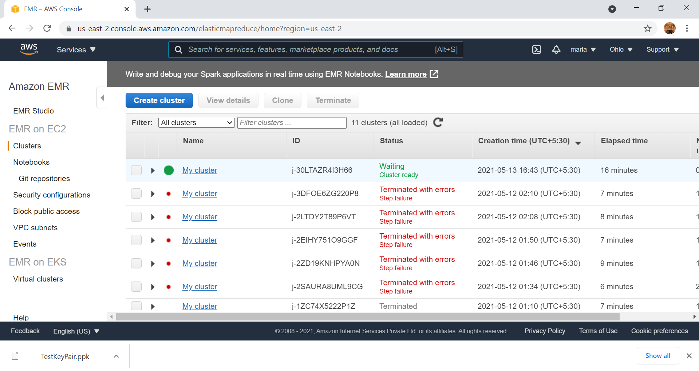

Slide 51
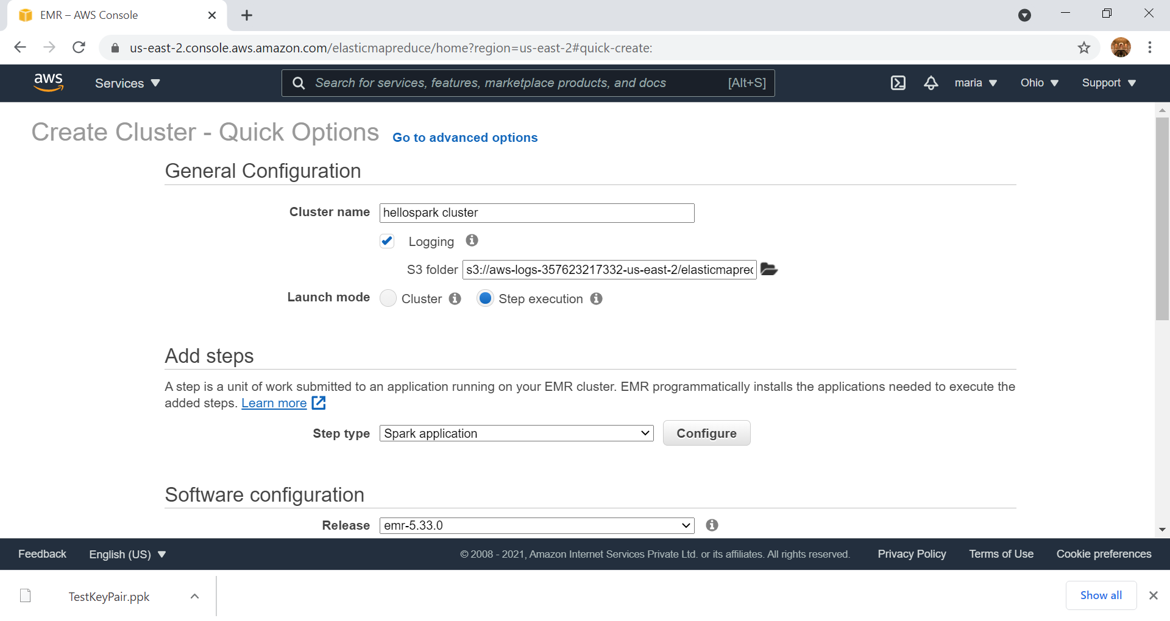
Click here to select the S3 bucket, where the Jar file is uploaded

Slide 52
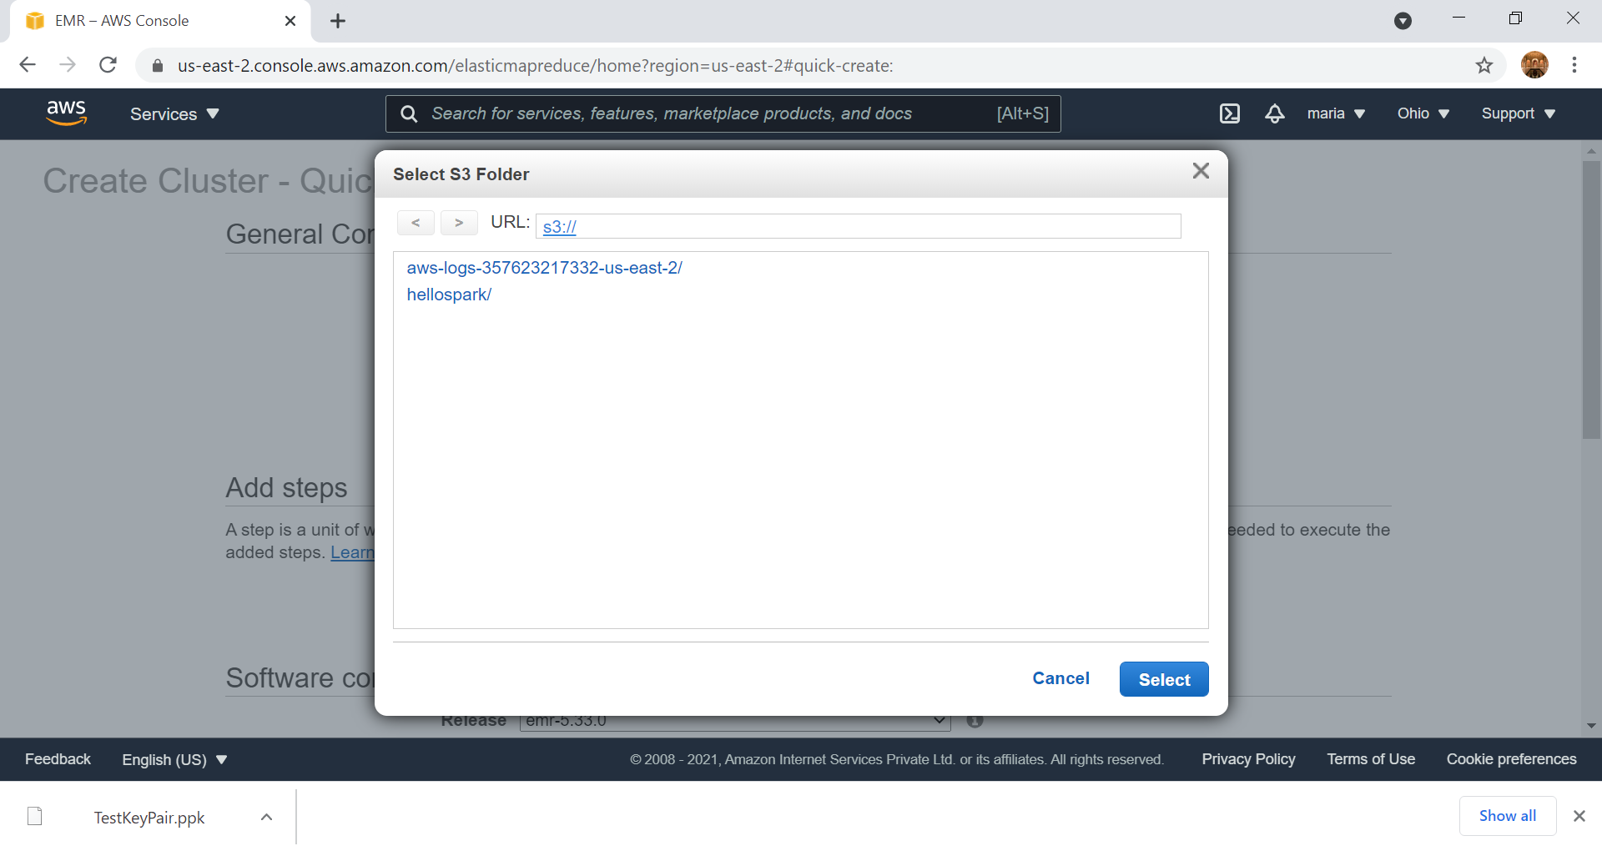

Slide 53
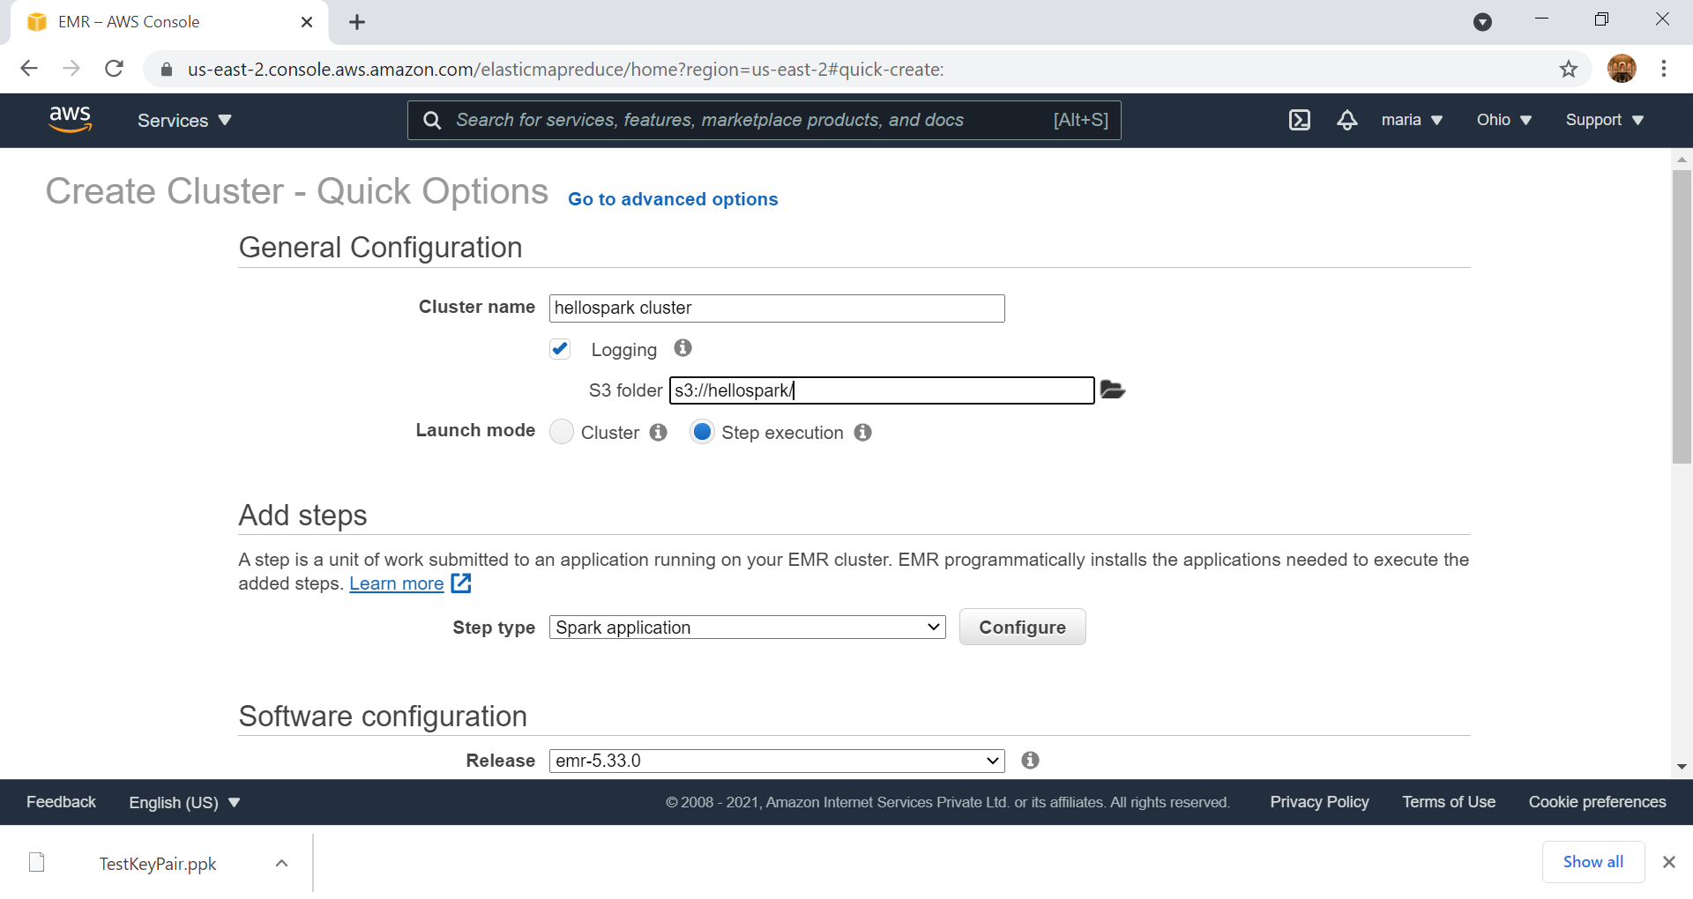
After selection, the bucket location is seen

Slide 54
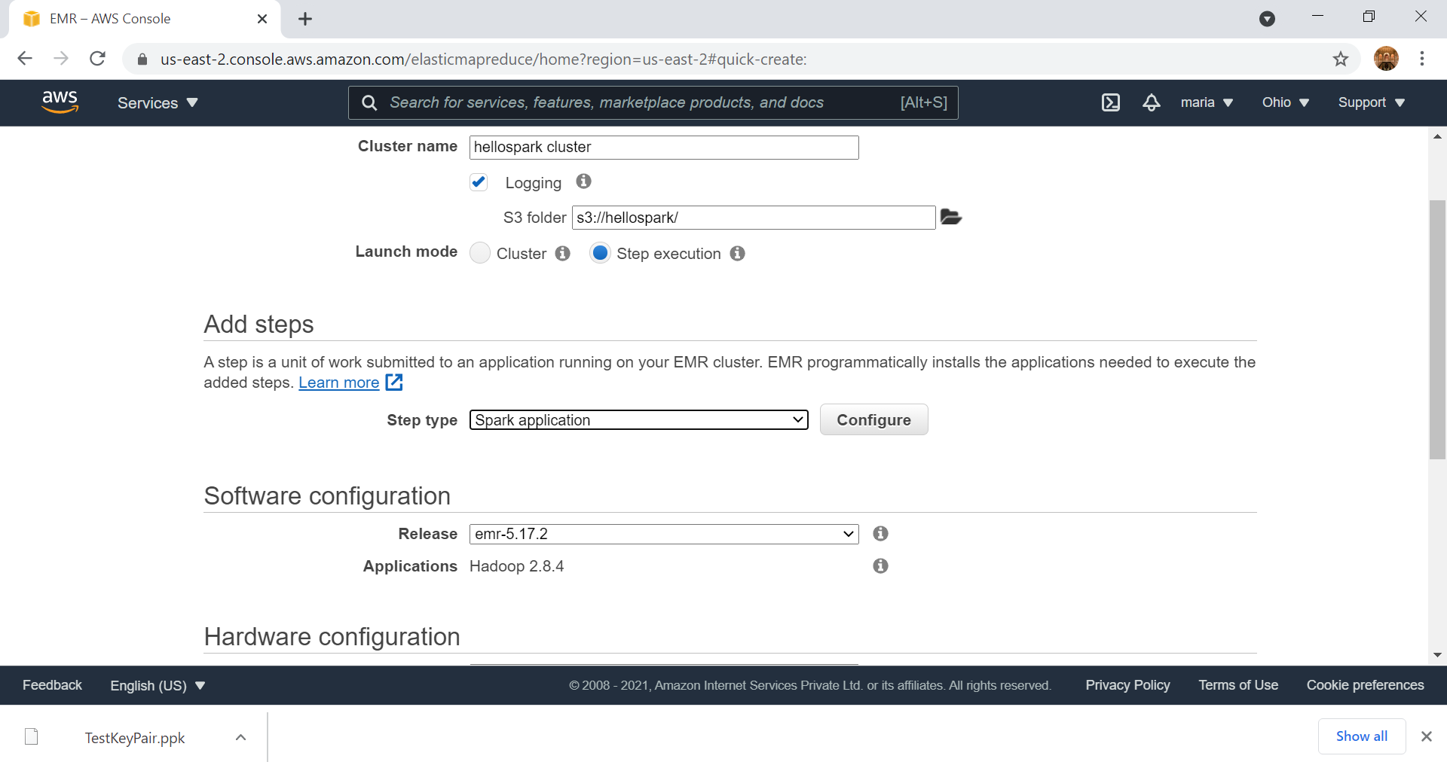
EMR release can be changed based on the spark version used in the built.sbt file of the program

Slide 55
Click on Configure

Slide 56
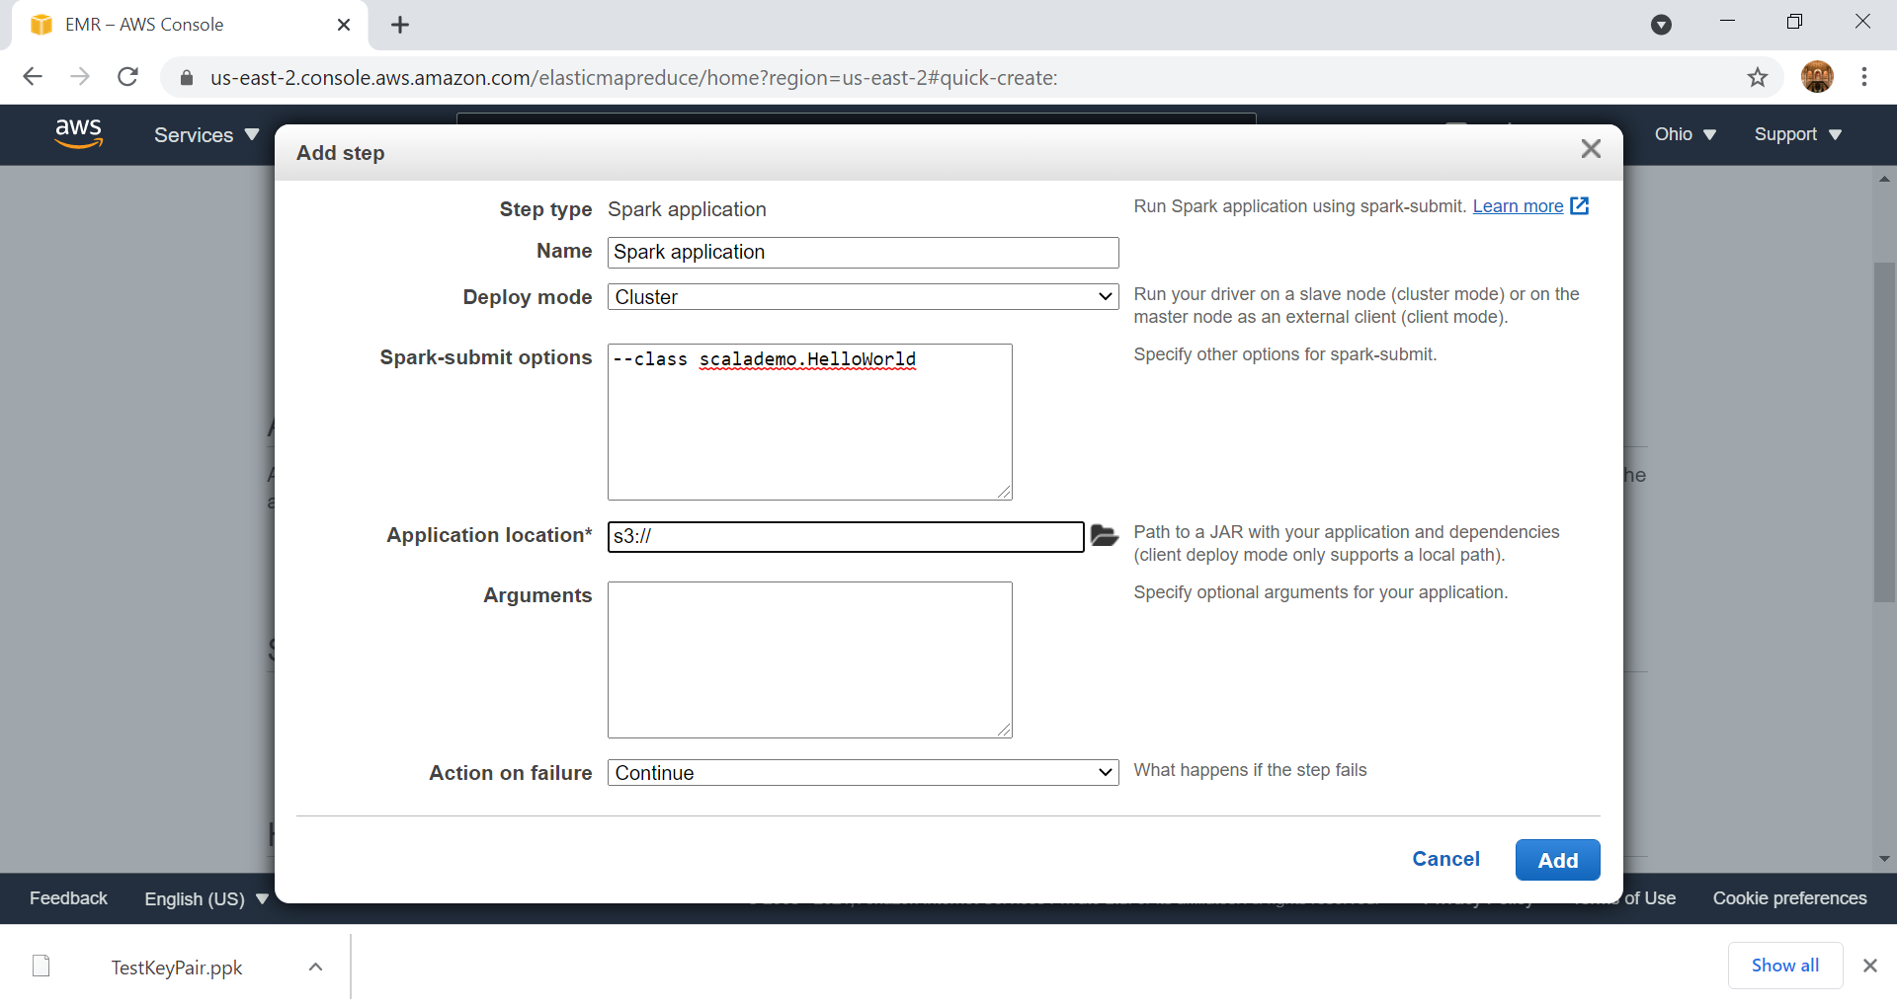
Enter the class, as per the program
--class scalademo.HelloWorld
Package = scalademo
Object - HelloWorld
After entering the class, click on this link to select the location of the Jar

Slide 57
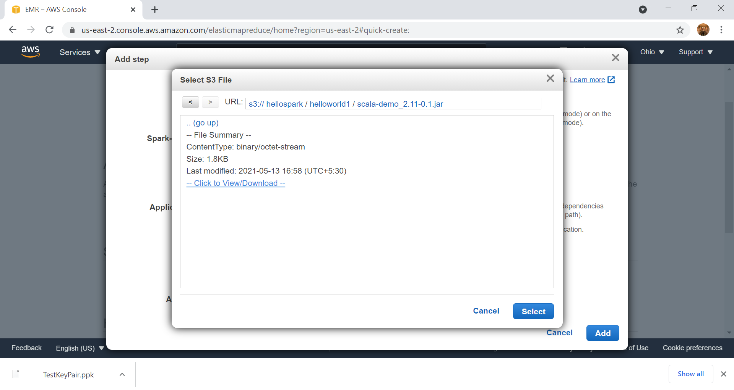

Slide 58
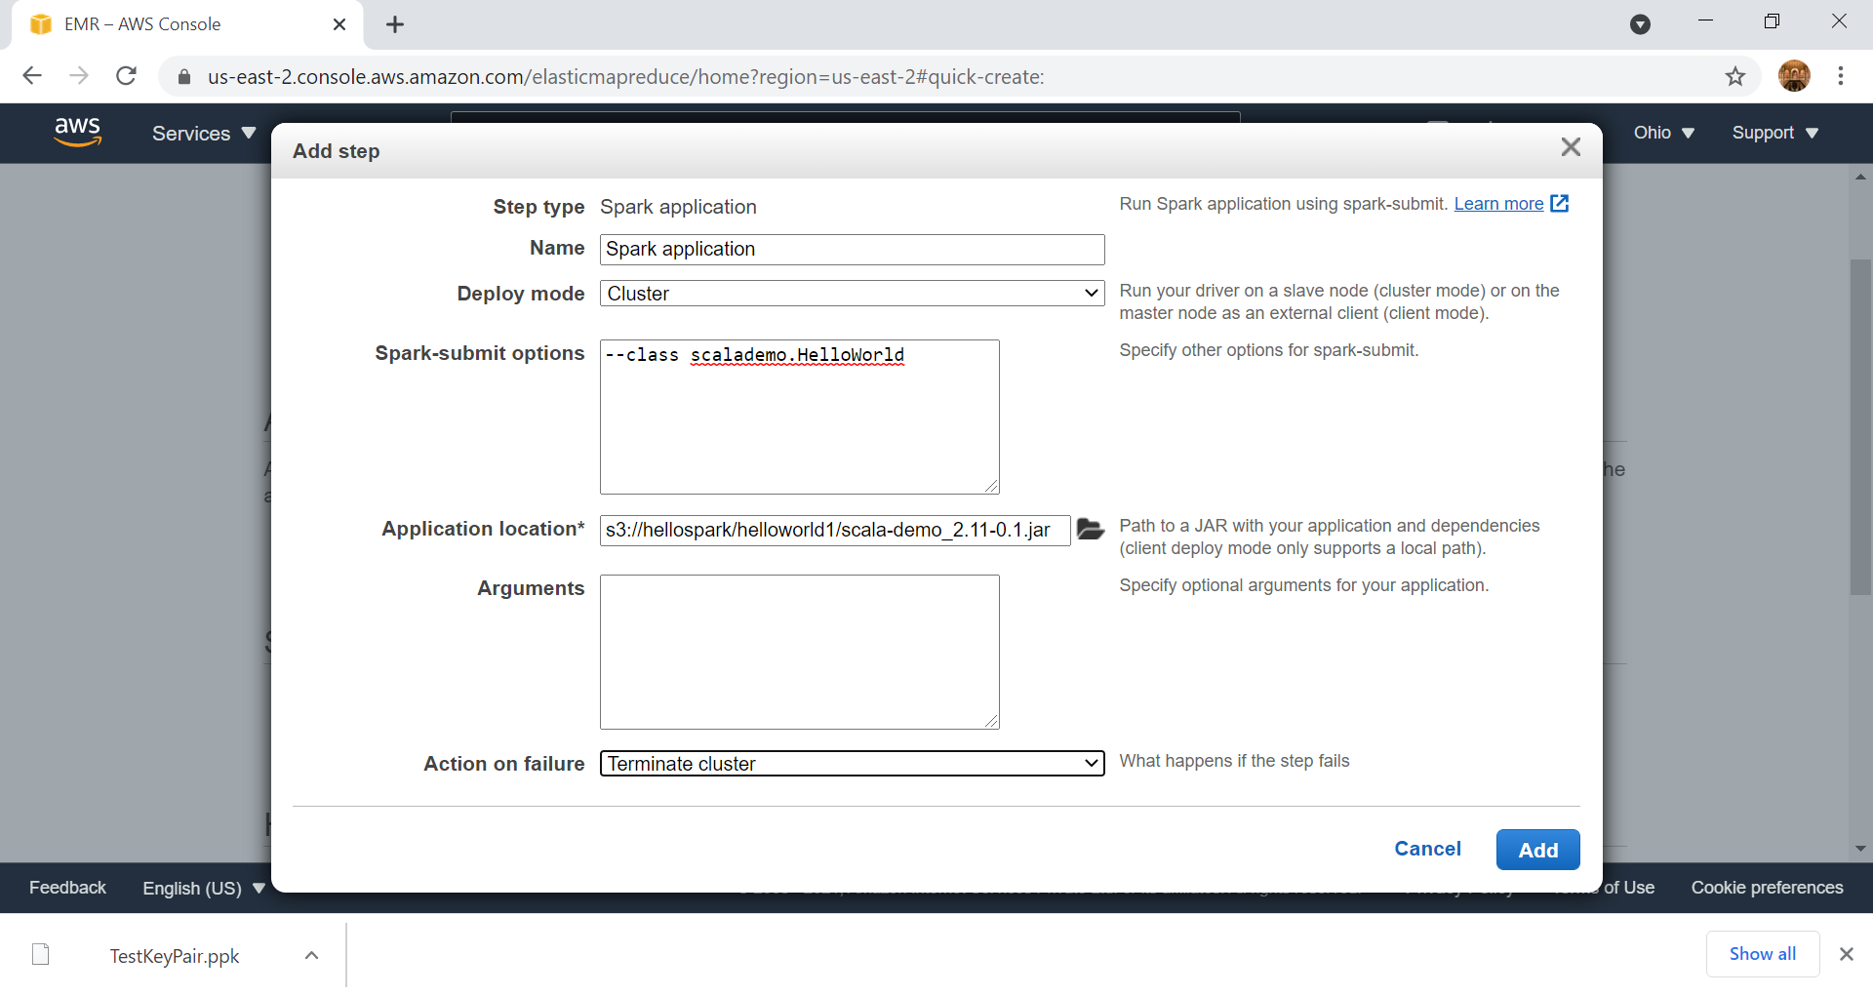

Slide 59
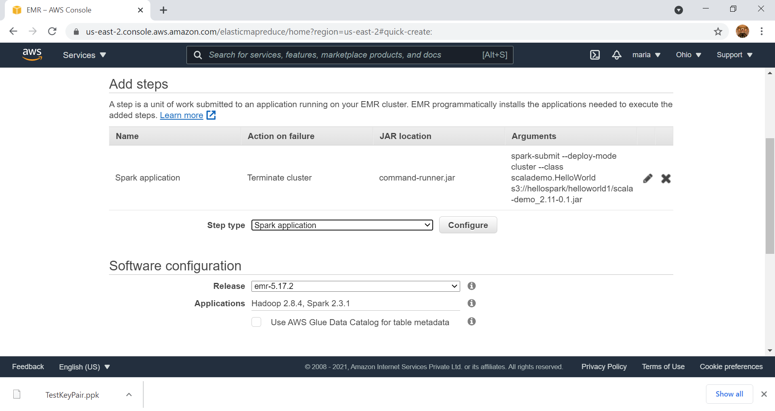

Slide 60
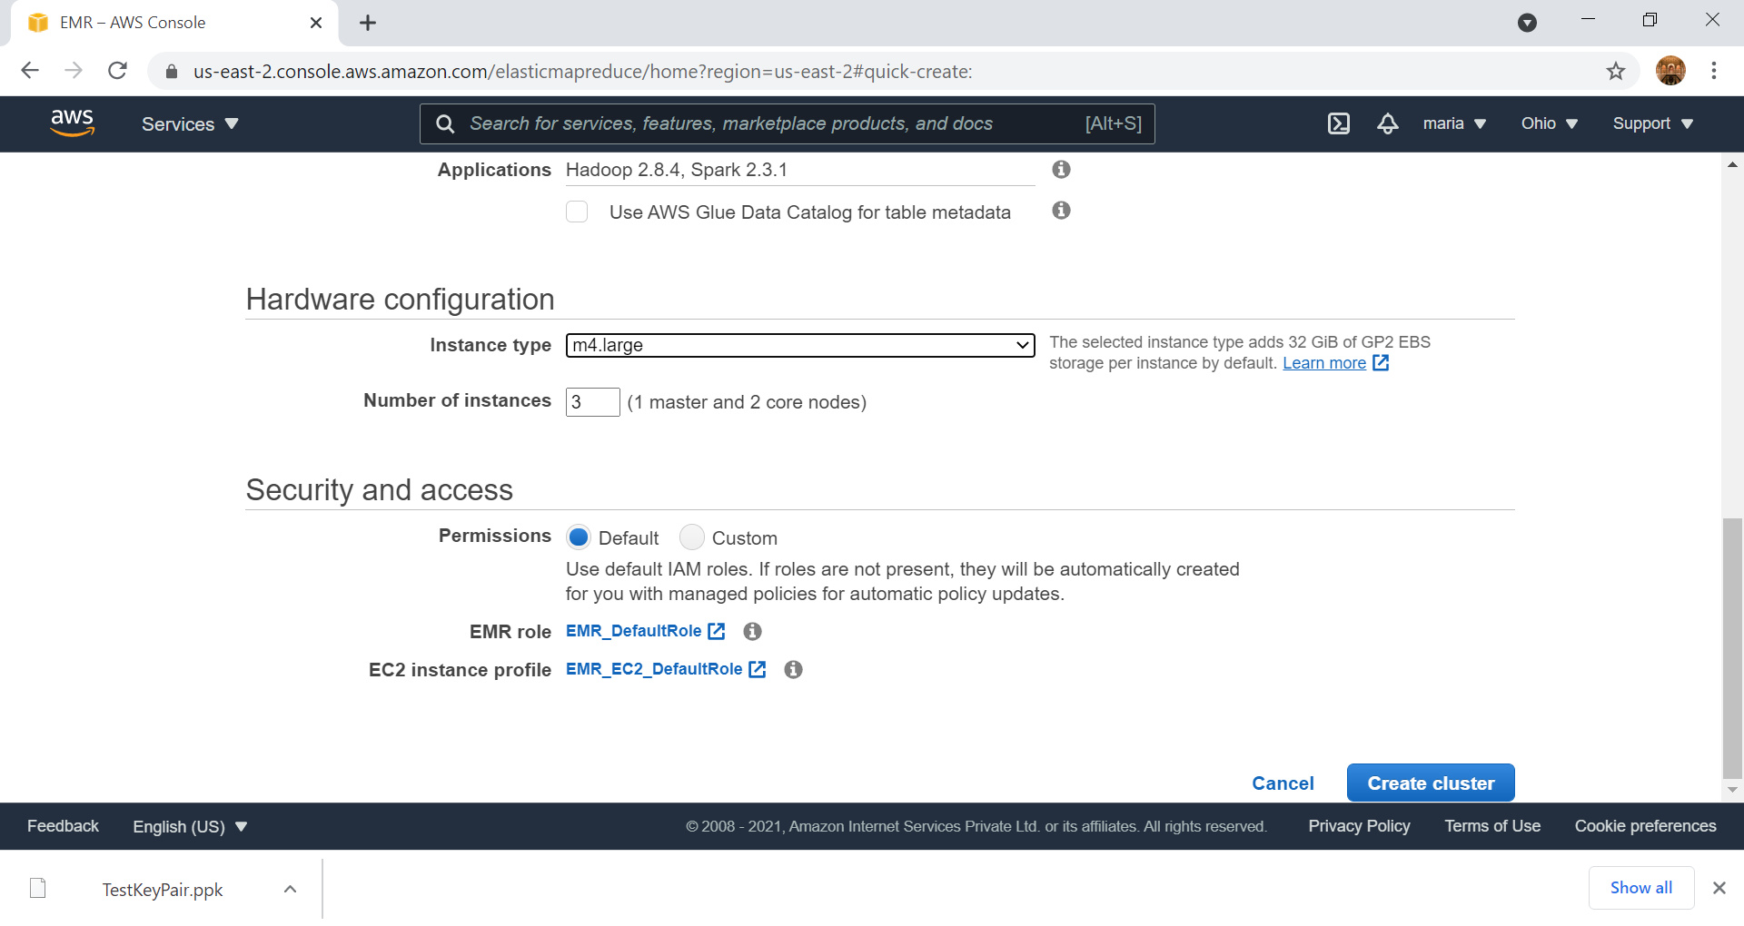

Slide 61
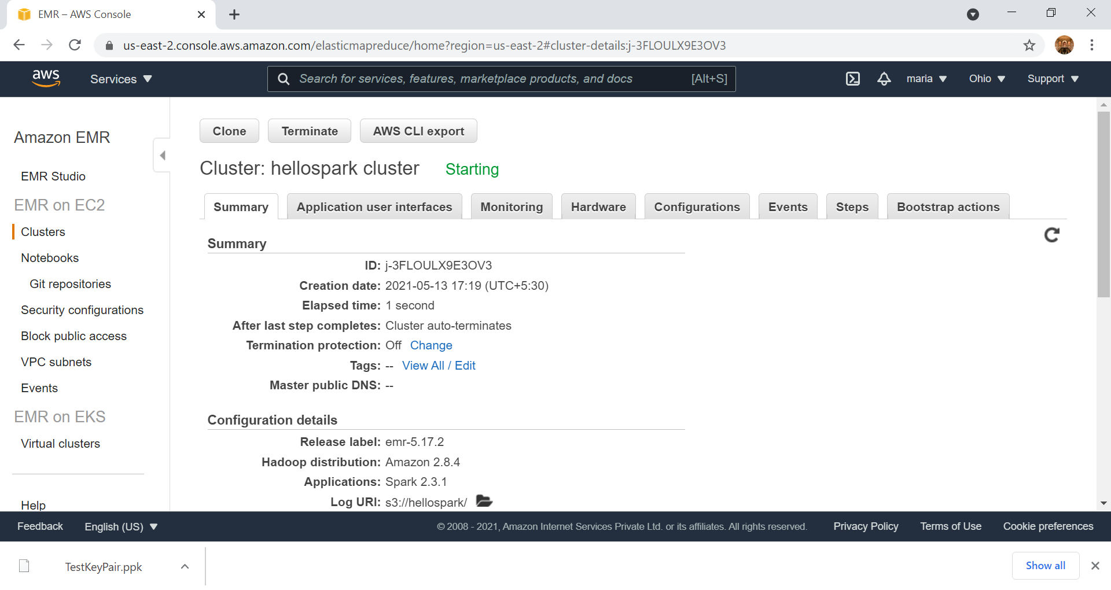

Slide 62
Starting – Running - Terminating
Click on the refresh icon to see the status passing from Starting to Running to Terminating — All steps completed
It will take about 10 mins to reach the terminating stage

Slide 63


Slide 64

Click here to find the output file

Slide 65


Slide 66


Slide 67


Slide 68


Slide 69


Slide 70


Slide 71
Delete S3 – Important Step to save Cost

Slide 72


Slide 73


Slide 74


Slide 75


Slide 76


Slide 77


Slide 78

Delete all the buckets one by one

Slide 79


Slide 80


Slide 81

No Buckets after deleting all the Buckets, Folders and Files

Slide 82
Ensure all EMR Clusters are Terminated

Slide 83

All the Cluster are in ‘Terminated’ status

Slide 84


Signout of AWS

Slide 85

Hope You Enjoyed Working on AWS EMR Cluster Thank You

